Slide 1
Lösung des n-Damenproblems auf einem adiabatischen Quantencomputer
Jugend Forscht Projekt von Jakov D. Wallbrecher, Jonathan Treffler & Paul Schappert

Slide 2
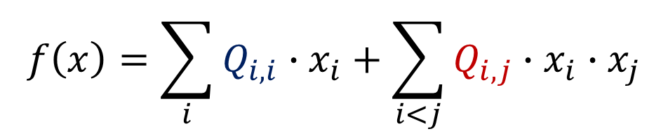
$$f\left(x\right)=\sum_{i}{Q_{i,i}∙x_{i}}+\sum_{i<j}{Q_{i,j}∙x_{i}∙x_{j}}$$
Was haben wir gemacht:
Optimierungsprobleme in QUBO-Form gebracht
Diese auf dem Dwave Quantenannealer gelöst
Dabei ging es nicht um die Lösung sondern ums formulieren
Notes:
positiver wert: Bestrafung (verschiedener Wert der Qbits)
negativer wert: Belohnung (beide 1)

Slide 3
Matrix finden
Optimierungsproblem
1. Darstellen
2. Regeln formulieren
3. Ggf. Vereinfachen
4. Matrix erschließen
per Hand / Computerprogramm
Formel / „direkt“

Slide 4
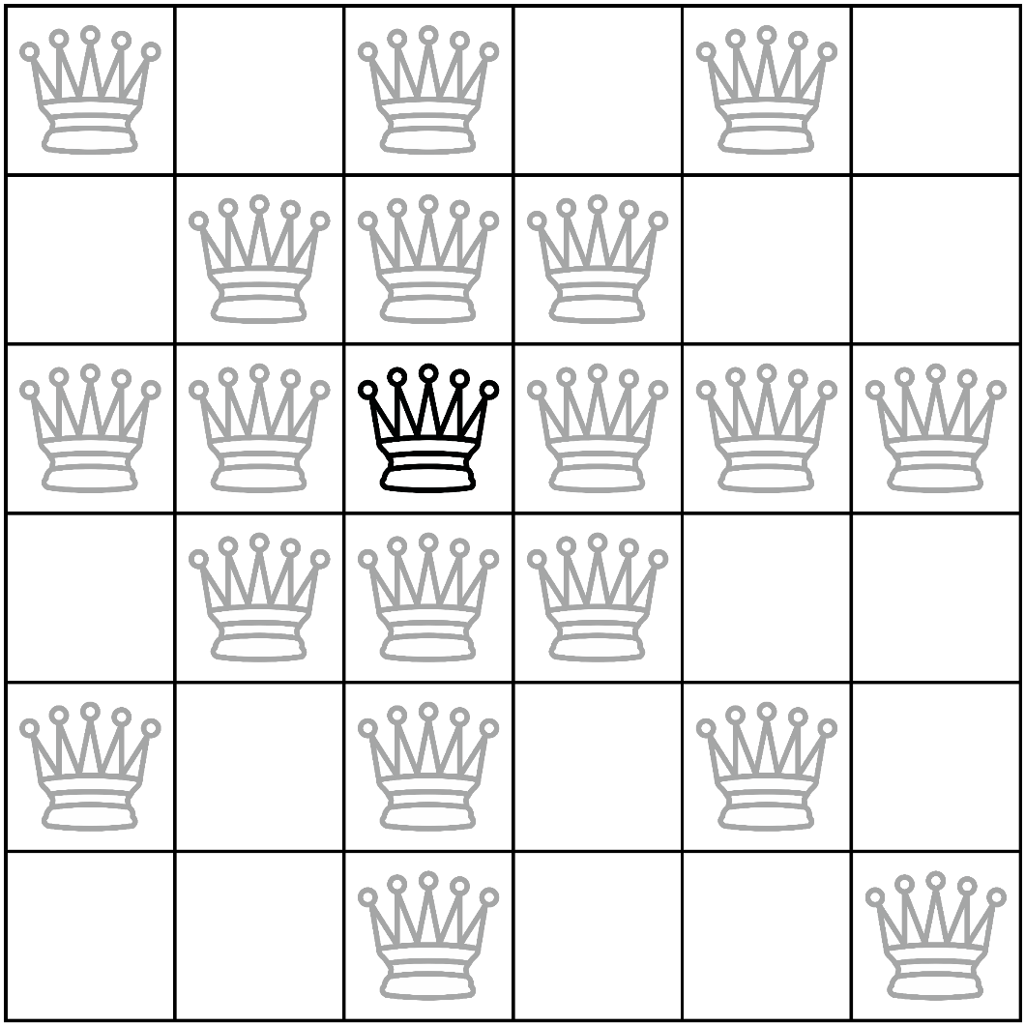
Das n-Damenproblem
Beim n-Damenproblem geht es darum, n Schachdamen so auf einem n x n Schachfeld zu positionieren, dass sie sich nicht bedrohen.
1. Darstellen
2. Regeln formulieren
3. Ggf. Vereinfachen
4. Matrix erschließen

Slide 5

Das n-Damenproblem
Beim n-Damenproblem geht es darum, n Schachdamen so auf einem n x n Schachfeld zu positionieren, dass sie sich nicht bedrohen.
Regeln:
pro Spalte genau eine Dame
pro Reihe genau eine Dame
pro Diagonale höchstens eine Dame
1. Darstellen
2. Regeln formulieren
3. Ggf. Vereinfachen
4. Matrix erschließen
Notes:
Paul
N-Damenproblem Allgemein (Damenzug)
Darstellen: 0 und 1
Regeln (Spalte – Reihe -Diagonale)

Slide 6
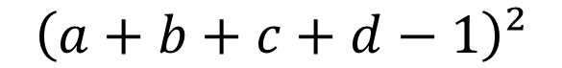

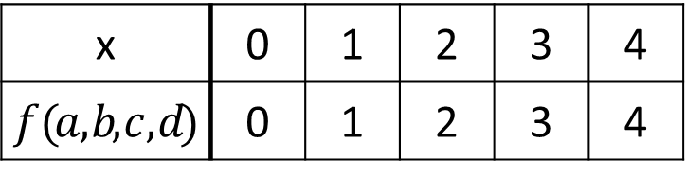
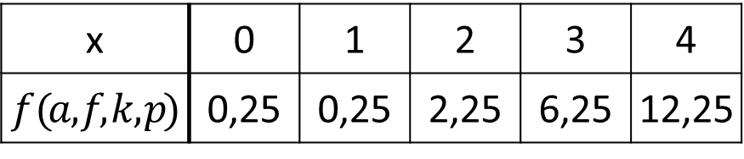

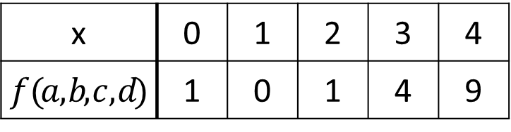

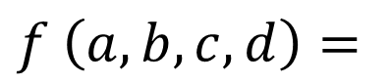
a | b | c | d
e | f | g | h
i | j | k | l
m | n | o | p
$$f \left(a, b,c, d\right)=$$
$$a+b+c+d$$
$$a+b+c+d−1$$
$$\left(a+b+c+d−1\right)²$$
x | 0 | 1 | 2 | 3 | 4
$$f (a , b,c , d)$$ | 0 | 1 | 2 | 3 | 4
x | 0 | 1 | 2 | 3 | 4
$$f (a , b,c , d)$$ | -1 | 0 | 1 | 2 | 3
x | 0 | 1 | 2 | 3 | 4
$$f (a , f,k , p)$$ | 0,25 | 0,25 | 2,25 | 6,25 | 12,25
x | 0 | 1 | 2 | 3 | 4
$$f (a , b,c , d)$$ | 1 | 0 | 1 | 4 | 9
x = Anzahl der besetzten Felder
$${f \left(a, f,k, p\right)=(a+f+k+p−0,5) }^{2}$$
$${f \left(a, e,i, m\right)=(a+e+i+m−1) }^{2}$$
1. Darstellen
2. Regeln formulieren
3. Ggf. Vereinfachen
4. Matrix erschließen
Notes:
Kostenfunktion finden: Minimum bei bester Lösung
Minimum muss bei 1 dame (da „pro Reihe genau eine“) -> alle addieren -> -1 -> quadrieren -> Minimum bei 1 dame
Reihe, Spalte, Diagonale

Slide 7
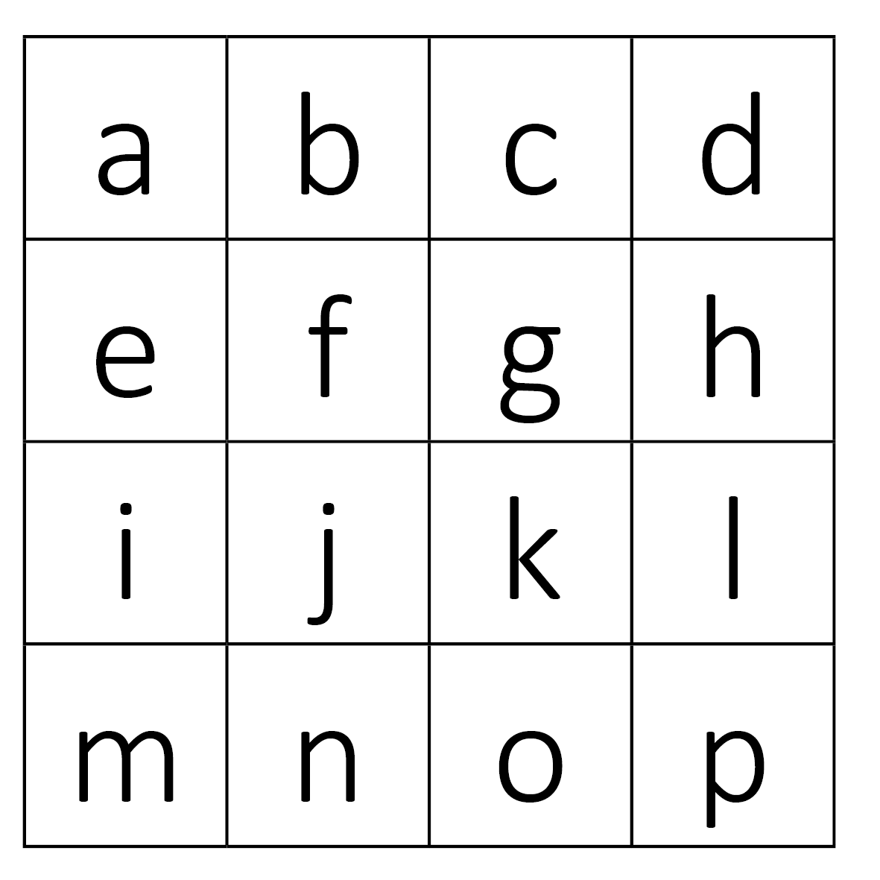
$${(a+b+c+d−1)}^{2}+{(e+f+g+h−1)}^{2}+{(i+j+k+l−1)}^{2}+{(m+n+o+p−1)}^{2}+$$
1. Darstellen
2. Regeln formulieren
3. Ggf. Vereinfachen
4. Matrix erschließen
$${(a+e+i+m−1)}^{2}+{(b+f+j+n−1)}^{2}+{(c+g+k+o−1)}^{2}+{(d+h+l+p−1)}^{2}+$$
$${(i+n−0,5)}^{2}+{(e+j+o−0,5)}^{2}+{(a+f+k+p−0,5)}^{2}+{(b+g+l−0,5)}^{2}+{\left(c+h−0,5\right)}^{2}+$$
$${(b+e−0,5)}^{2}+{(c+f+i−0,5)}^{2}+{(d+g+j+m−0,5)}^{2}+{(h+k+n−0,5)}^{2}+{\left(l+o−0,5\right)}^{2}$$
 | a | b | c | d | e | f | g | h | i | j | k | l | m | n | o | p
a | -2 | 2 | 2 | 2 | 2 | 2 | 0 | 0 | 2 | 0 | 2 | 0 | 2 | 0 | 0 | 2
b | 0 | -2 | 2 | 2 | 2 | 2 | 2 | 0 | 0 | 2 | 0 | 2 | 0 | 2 | 0 | 0
c | 0 | 0 | -2 | 2 | 0 | 2 | 2 | 2 | 2 | 0 | 2 | 0 | 0 | 0 | 2 | 0
d | 0 | 0 | 0 | -2 | 0 | 0 | 2 | 2 | 0 | 2 | 0 | 2 | 2 | 0 | 0 | 2
e | 0 | 0 | 0 | 0 | -2 | 2 | 2 | 2 | 2 | 2 | 0 | 0 | 2 | 0 | 2 | 0
f | 0 | 0 | 0 | 0 | 0 | -2 | 2 | 2 | 2 | 2 | 2 | 0 | 0 | 2 | 0 | 2
g | 0 | 0 | 0 | 0 | 0 | 0 | -2 | 2 | 0 | 2 | 2 | 2 | 2 | 0 | 2 | 0
h | 0 | 0 | 0 | 0 | 0 | 0 | 0 | -2 | 0 | 0 | 2 | 2 | 0 | 2 | 0 | 2
i | 0 | 0 | 0 | 0 | 0 | 0 | 0 | 0 | -2 | 2 | 2 | 2 | 2 | 2 | 0 | 0
j | 0 | 0 | 0 | 0 | 0 | 0 | 0 | 0 | 0 | -2 | 2 | 2 | 2 | 2 | 2 | 0
k | 0 | 0 | 0 | 0 | 0 | 0 | 0 | 0 | 0 | 0 | -2 | 2 | 0 | 2 | 2 | 2
l | 0 | 0 | 0 | 0 | 0 | 0 | 0 | 0 | 0 | 0 | 0 | -2 | 0 | 0 | 2 | 2
m | 0 | 0 | 0 | 0 | 0 | 0 | 0 | 0 | 0 | 0 | 0 | 0 | -2 | 2 | 2 | 2
n | 0 | 0 | 0 | 0 | 0 | 0 | 0 | 0 | 0 | 0 | 0 | 0 | 0 | -2 | 2 | 2
o | 0 | 0 | 0 | 0 | 0 | 0 | 0 | 0 | 0 | 0 | 0 | 0 | 0 | 0 | -2 | 2
p | 0 | 0 | 0 | 0 | 0 | 0 | 0 | 0 | 0 | 0 | 0 | 0 | 0 | 0 | 0 | -2
2 a k
Notes:
Übertragen in Matrix
Beispiel am Feld
Diagonale -2 da Grundbelohnung

Slide 8
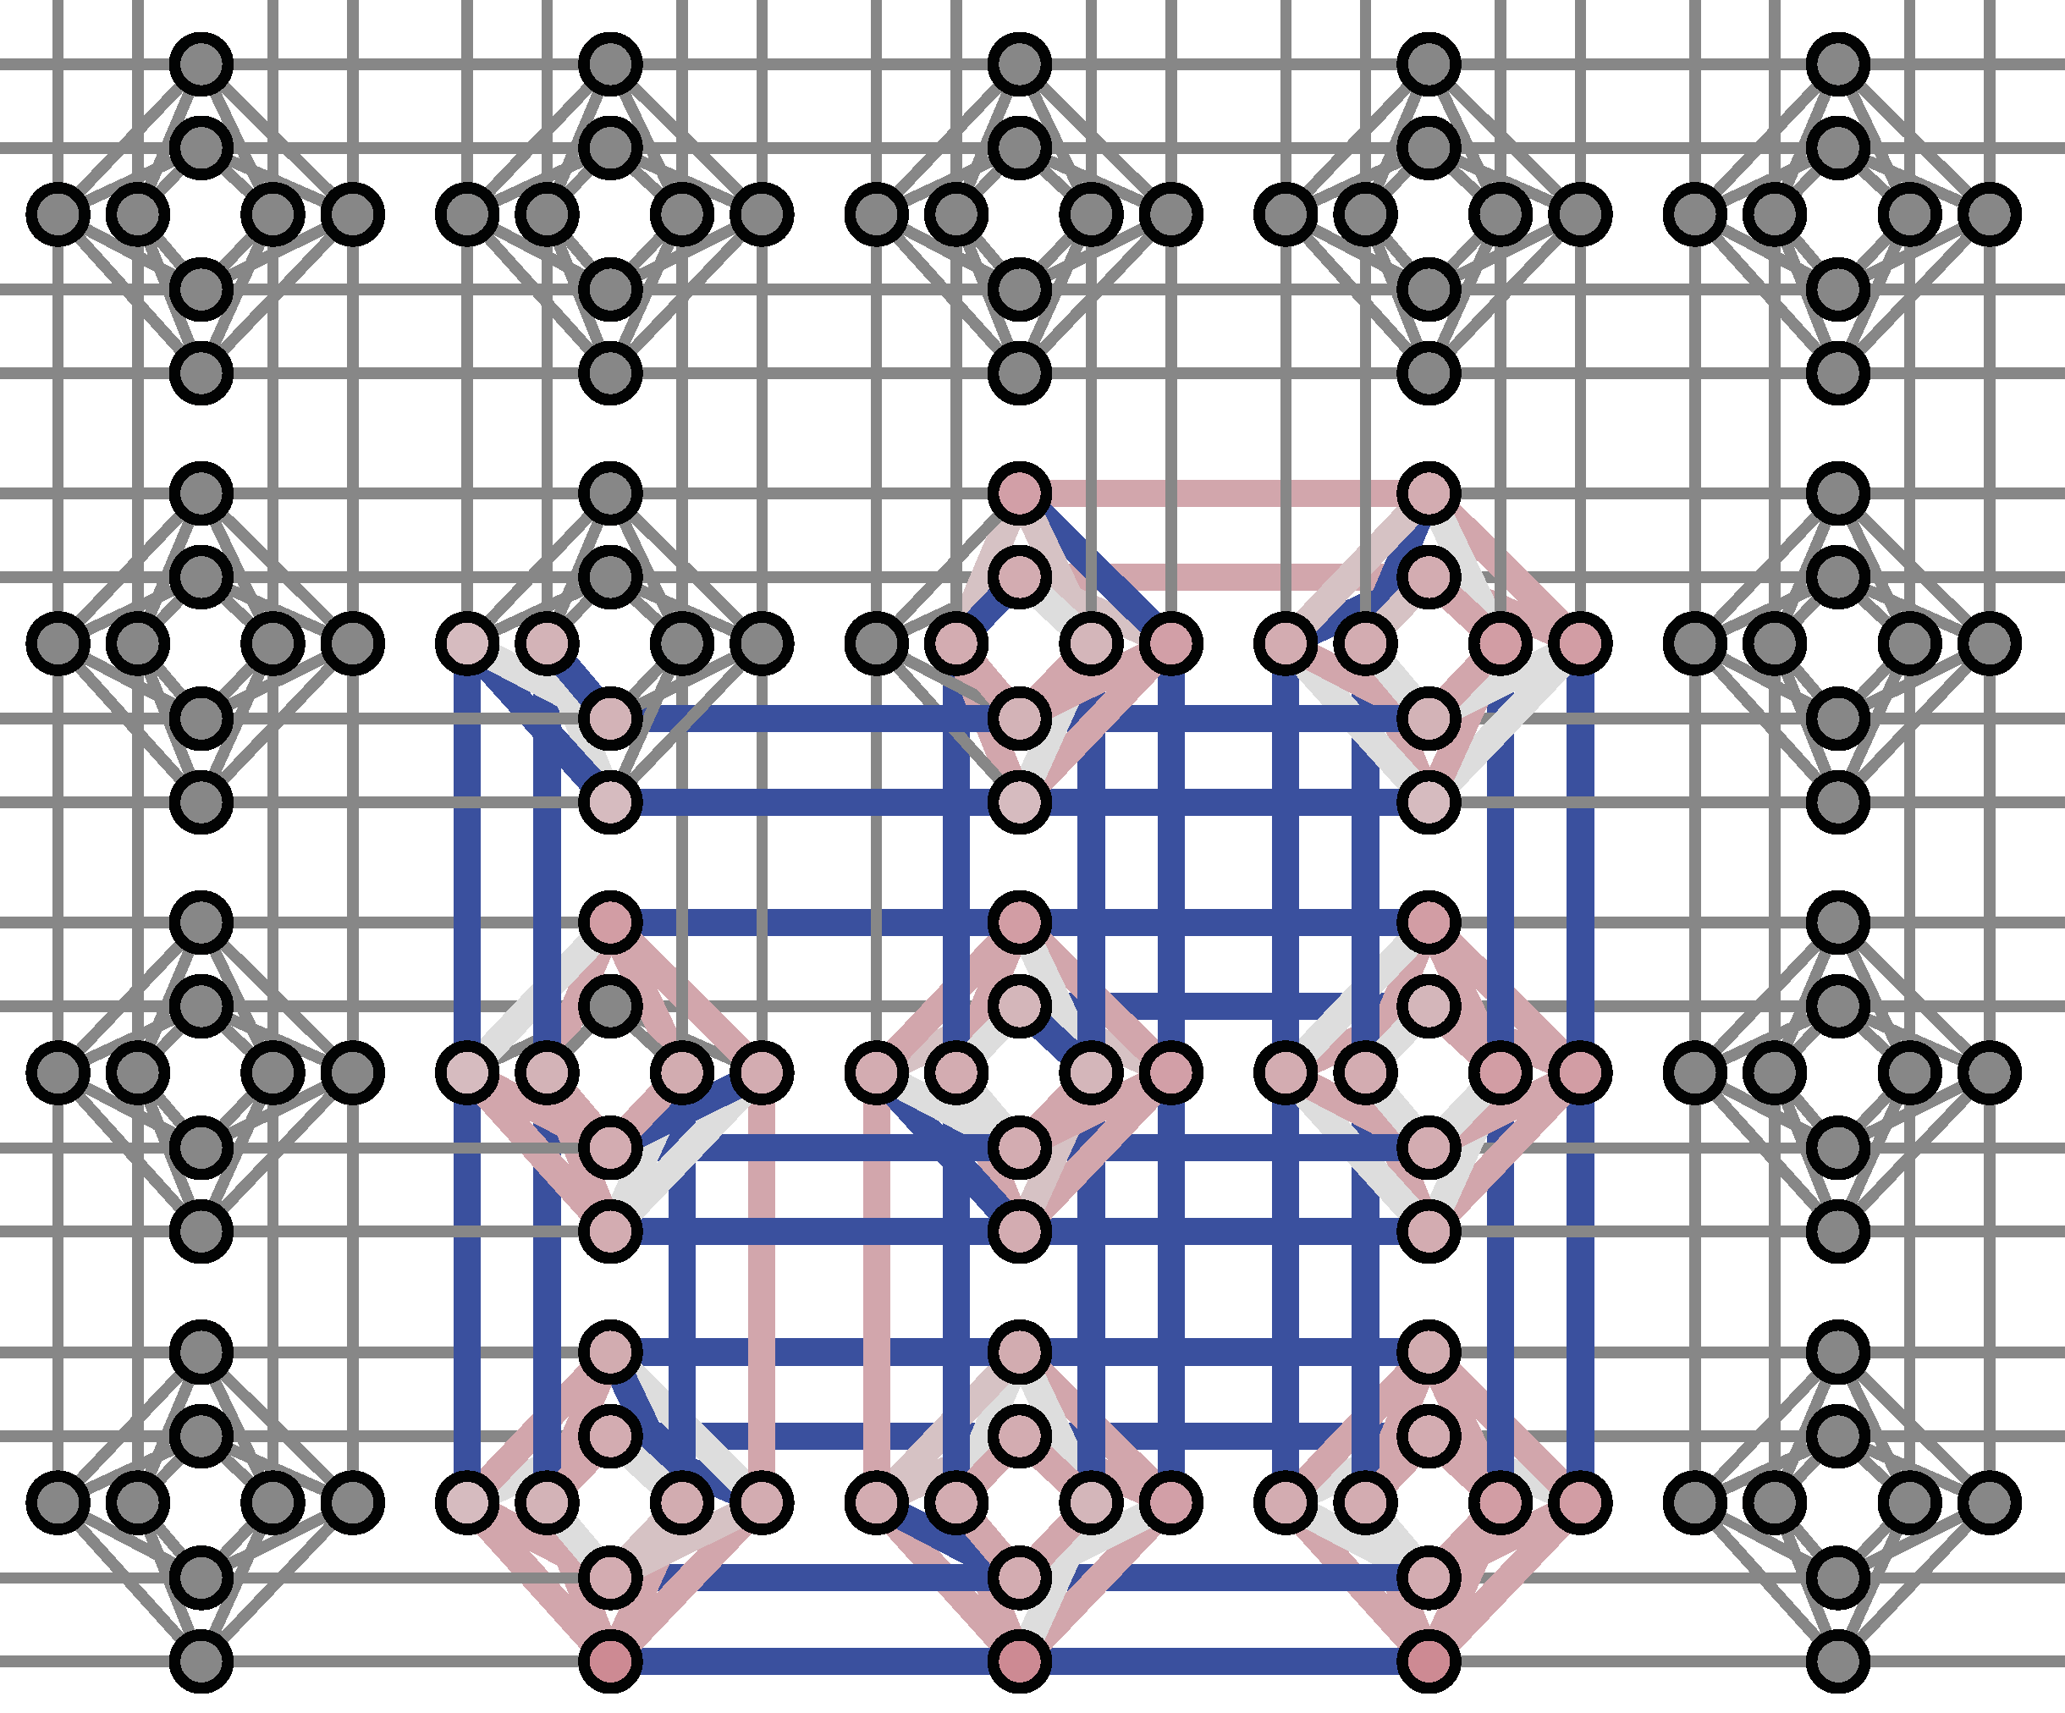
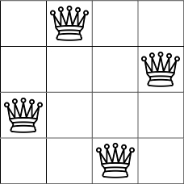
4-Damenproblem
Hamilton-Matrix
Embedding
Lösung
-2 | 2 | 2 | 2 | 2 | 2 | 0 | 0 | 2 | 0 | 2 | 0 | 2 | 0 | 0 | 2
0 | -2 | 2 | 2 | 2 | 2 | 2 | 0 | 0 | 2 | 0 | 2 | 0 | 2 | 0 | 0
0 | 0 | -2 | 2 | 0 | 2 | 2 | 2 | 2 | 0 | 2 | 0 | 0 | 0 | 2 | 0
0 | 0 | 0 | -2 | 0 | 0 | 2 | 2 | 0 | 2 | 0 | 2 | 2 | 0 | 0 | 2
0 | 0 | 0 | 0 | -2 | 2 | 2 | 2 | 2 | 2 | 0 | 0 | 2 | 0 | 2 | 0
0 | 0 | 0 | 0 | 0 | -2 | 2 | 2 | 2 | 2 | 2 | 0 | 0 | 2 | 0 | 2
0 | 0 | 0 | 0 | 0 | 0 | -2 | 2 | 0 | 2 | 2 | 2 | 2 | 0 | 2 | 0
0 | 0 | 0 | 0 | 0 | 0 | 0 | -2 | 0 | 0 | 2 | 2 | 0 | 2 | 0 | 2
0 | 0 | 0 | 0 | 0 | 0 | 0 | 0 | -2 | 2 | 2 | 2 | 2 | 2 | 0 | 0
0 | 0 | 0 | 0 | 0 | 0 | 0 | 0 | 0 | -2 | 2 | 2 | 2 | 2 | 2 | 0
0 | 0 | 0 | 0 | 0 | 0 | 0 | 0 | 0 | 0 | -2 | 2 | 0 | 2 | 2 | 2
0 | 0 | 0 | 0 | 0 | 0 | 0 | 0 | 0 | 0 | 0 | -2 | 0 | 0 | 2 | 2
0 | 0 | 0 | 0 | 0 | 0 | 0 | 0 | 0 | 0 | 0 | 0 | -2 | 2 | 2 | 2
0 | 0 | 0 | 0 | 0 | 0 | 0 | 0 | 0 | 0 | 0 | 0 | 0 | -2 | 2 | 2
0 | 0 | 0 | 0 | 0 | 0 | 0 | 0 | 0 | 0 | 0 | 0 | 0 | 0 | -2 | 2
0 | 0 | 0 | 0 | 0 | 0 | 0 | 0 | 0 | 0 | 0 | 0 | 0 | 0 | 0 | -2

Slide 9

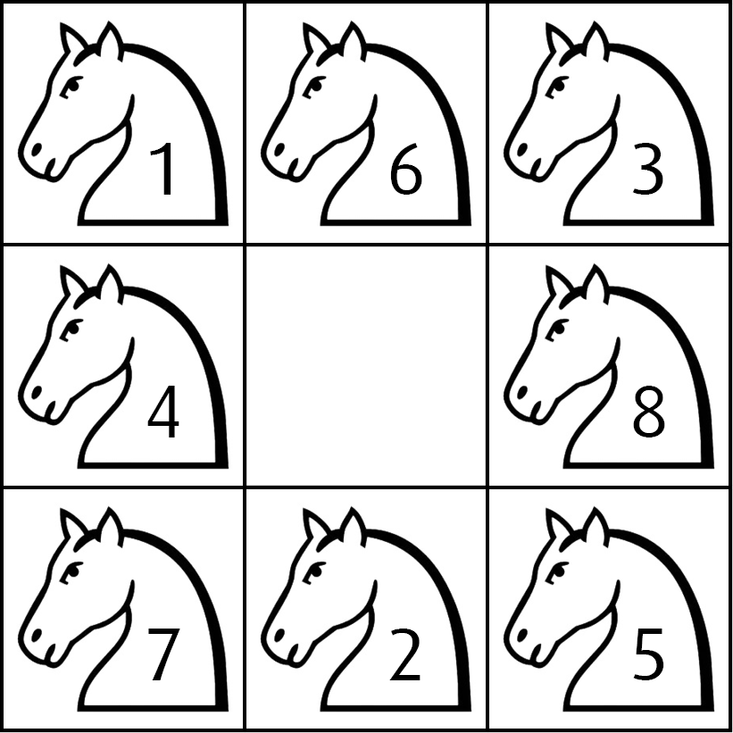
Das Springerproblem
Der Springerzug:
Mögliche Lösung:
1. Darstellen
2. Regeln formulieren
3. Ggf. Vereinfachen
4. Matrix erschließen
Beim Springerproblem geht es darum, auf einem Schachfeld eine Route zu finden, bei der ein Springer jedes Feld genau einmal besucht.
Position 1
Position 2
Position 3
Regeln:
Pro Zeitebene genau ein Springer
Kein Feld doppelt betreten
Einhaltung des Springerzugs

Slide 10
Das Springerproblem
1. Darstellen
2. Regeln formulieren
3. Ggf. Vereinfachen
4. Matrix erschließen
 | b
d |  | e
 | g
a | b | c
d |  | e
f | g | h
b | d
e | g
a |  | c
f |  | h
a | b | c
d |  | e
f | g | h
a | c
f | h
Notes:
bestraft: übereinander, auf einer ebene, nicht-springer-zug
belohnt: Grundbelohnung, richtiger Springerzug

Slide 11
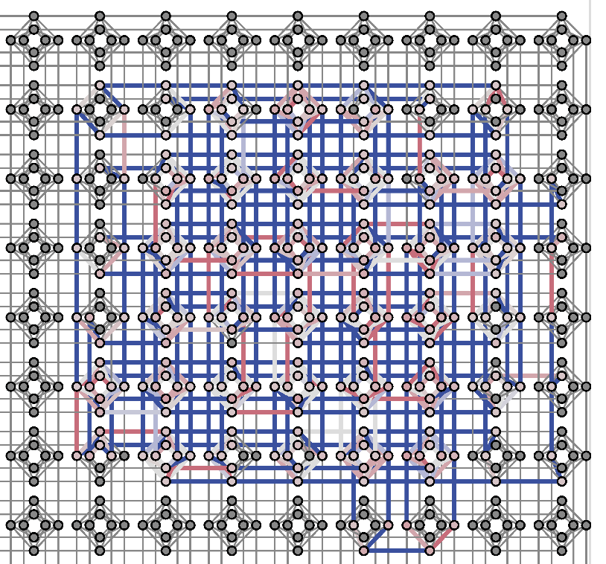
Hamilton-Matrix des Springerproblems
0 | 2 | 2 | 2 | 2 | 2 | 2 | 2 | 4 | 0 | 0 | 0 | 0 | 0 | 2 | 0 | 4 | 0 | 0 | 0 | 0 | 2 | 0 | 0 | 4 | 0 | 0 | 0 | 2 | 0 | 0 | 0 | 4 | 0 | 0 | 2 | 0 | 0 | 0 | 0 | 4 | 0 | 2 | 0 | 0 | 0 | 0 | 0 | 4
0 | -2 | 2 | 2 | 2 | 2 | 2 | 2 | 2 | 2 | 0 | 0 | 0 | 0 | 0 | 2 | 0 | 2 | 0 | 0 | 0 | 0 | 2 | 0 | 0 | 2 | 0 | 0 | 0 | 2 | 0 | 0 | 0 | 2 | 0 | 0 | 2 | 0 | 0 | 0 | 0 | 2 | 0 | 2 | 0 | 0 | 0 | 0 | 0
0 | 0 | -2 | 2 | 2 | 2 | 2 | 0 | 2 | 2 | 2 | 0 | 0 | 0 | 2 | 0 | 2 | 0 | 2 | 0 | 0 | 0 | 0 | 2 | 0 | 0 | 2 | 0 | 0 | 0 | 2 | 0 | 0 | 0 | 2 | 0 | 0 | 2 | 0 | 0 | 0 | 0 | 0 | 0 | 2 | 0 | 0 | 0 | 0
0 | 0 | 0 | -2 | 2 | 2 | 2 | 0 | 0 | 2 | 2 | 2 | 0 | 0 | 0 | 2 | 0 | 2 | 0 | 2 | 0 | 2 | 0 | 0 | 2 | 0 | 0 | 2 | 0 | 0 | 0 | 2 | 0 | 0 | 0 | 0 | 0 | 0 | 2 | 0 | 0 | 0 | 0 | 0 | 0 | 2 | 0 | 0 | 0
0 | 0 | 0 | 0 | -2 | 2 | 2 | 0 | 0 | 0 | 2 | 2 | 2 | 0 | 0 | 0 | 2 | 0 | 2 | 0 | 2 | 0 | 2 | 0 | 0 | 2 | 0 | 0 | 2 | 0 | 0 | 0 | 2 | 0 | 0 | 0 | 0 | 0 | 0 | 2 | 0 | 0 | 0 | 0 | 0 | 0 | 2 | 0 | 0
0 | 0 | 0 | 0 | 0 | -2 | 2 | 0 | 0 | 0 | 0 | 2 | 2 | 2 | 0 | 0 | 0 | 2 | 0 | 2 | 0 | 0 | 0 | 2 | 0 | 0 | 2 | 0 | 0 | 2 | 0 | 0 | 0 | 2 | 0 | 2 | 0 | 0 | 0 | 0 | 2 | 0 | 0 | 0 | 0 | 0 | 0 | 2 | 0
0 | 0 | 0 | 0 | 0 | 0 | -2 | 0 | 0 | 0 | 0 | 0 | 0 | 2 | 0 | 0 | 0 | 0 | 0 | 0 | 2 | 0 | 0 | 0 | 0 | 0 | 0 | 2 | 0 | 0 | 0 | 0 | 0 | 0 | 2 | 0 | 0 | 0 | 0 | 0 | 0 | 2 | 0 | 0 | 0 | 0 | 0 | 0 | 2
0 | 0 | 0 | 0 | 0 | 0 | 0 | -2 | 2 | 2 | 2 | 2 | 2 | 2 | 2 | 2 | 0 | 0 | 0 | 0 | 0 | 2 | 0 | 2 | 0 | 0 | 0 | 0 | 2 | 0 | 0 | 2 | 0 | 0 | 0 | 2 | 0 | 0 | 0 | 2 | 0 | 0 | 2 | 0 | 0 | 0 | 0 | 2 | 0
0 | 0 | 0 | 0 | 0 | 0 | 0 | 0 | 0 | 2 | 2 | 2 | 2 | 2 | 2 | 2 | 4 | 0 | 0 | 0 | 0 | 0 | 2 | 0 | 4 | 0 | 0 | 0 | 0 | 2 | 0 | 0 | 4 | 0 | 0 | 0 | 2 | 0 | 0 | 0 | 4 | 0 | 0 | 2 | 0 | 0 | 0 | 0 | 4
0 | 0 | 0 | 0 | 0 | 0 | 0 | 0 | 0 | -2 | 2 | 2 | 2 | 2 | 0 | 2 | 2 | 2 | 0 | 0 | 0 | 2 | 0 | 2 | 0 | 2 | 0 | 0 | 0 | 0 | 2 | 0 | 0 | 2 | 0 | 0 | 0 | 2 | 0 | 0 | 0 | 2 | 0 | 0 | 2 | 0 | 0 | 0 | 0
0 | 0 | 0 | 0 | 0 | 0 | 0 | 0 | 0 | 0 | -2 | 2 | 2 | 2 | 0 | 0 | 2 | 2 | 2 | 0 | 0 | 0 | 2 | 0 | 2 | 0 | 2 | 0 | 2 | 0 | 0 | 2 | 0 | 0 | 2 | 0 | 0 | 0 | 2 | 0 | 0 | 0 | 0 | 0 | 0 | 2 | 0 | 0 | 0
0 | 0 | 0 | 0 | 0 | 0 | 0 | 0 | 0 | 0 | 0 | -2 | 2 | 2 | 0 | 0 | 0 | 2 | 2 | 2 | 0 | 0 | 0 | 2 | 0 | 2 | 0 | 2 | 0 | 2 | 0 | 0 | 2 | 0 | 0 | 2 | 0 | 0 | 0 | 2 | 0 | 0 | 0 | 0 | 0 | 0 | 2 | 0 | 0
0 | 0 | 0 | 0 | 0 | 0 | 0 | 0 | 0 | 0 | 0 | 0 | -2 | 2 | 0 | 0 | 0 | 0 | 2 | 2 | 2 | 0 | 0 | 0 | 2 | 0 | 2 | 0 | 0 | 0 | 2 | 0 | 0 | 2 | 0 | 0 | 2 | 0 | 0 | 0 | 2 | 0 | 2 | 0 | 0 | 0 | 0 | 2 | 0
0 | 0 | 0 | 0 | 0 | 0 | 0 | 0 | 0 | 0 | 0 | 0 | 0 | -2 | 0 | 0 | 0 | 0 | 0 | 0 | 2 | 0 | 0 | 0 | 0 | 0 | 0 | 2 | 0 | 0 | 0 | 0 | 0 | 0 | 2 | 0 | 0 | 0 | 0 | 0 | 0 | 2 | 0 | 0 | 0 | 0 | 0 | 0 | 2
0 | 0 | 0 | 0 | 0 | 0 | 0 | 0 | 0 | 0 | 0 | 0 | 0 | 0 | -2 | 2 | 2 | 2 | 2 | 2 | 2 | 2 | 2 | 0 | 0 | 0 | 0 | 0 | 2 | 0 | 2 | 0 | 0 | 0 | 0 | 2 | 0 | 0 | 2 | 0 | 0 | 0 | 2 | 0 | 0 | 0 | 2 | 0 | 0
0 | 0 | 0 | 0 | 0 | 0 | 0 | 0 | 0 | 0 | 0 | 0 | 0 | 0 | 0 | -2 | 2 | 2 | 2 | 2 | 2 | 2 | 2 | 2 | 0 | 0 | 0 | 0 | 0 | 2 | 0 | 2 | 0 | 0 | 0 | 0 | 2 | 0 | 0 | 2 | 0 | 0 | 0 | 2 | 0 | 0 | 0 | 2 | 0
0 | 0 | 0 | 0 | 0 | 0 | 0 | 0 | 0 | 0 | 0 | 0 | 0 | 0 | 0 | 0 | 0 | 2 | 2 | 2 | 2 | 0 | 2 | 2 | 4 | 0 | 0 | 0 | 2 | 0 | 2 | 0 | 4 | 0 | 0 | 0 | 0 | 2 | 0 | 0 | 4 | 0 | 0 | 0 | 2 | 0 | 0 | 0 | 4
0 | 0 | 0 | 0 | 0 | 0 | 0 | 0 | 0 | 0 | 0 | 0 | 0 | 0 | 0 | 0 | 0 | -2 | 2 | 2 | 2 | 0 | 0 | 2 | 2 | 2 | 0 | 0 | 0 | 2 | 0 | 2 | 0 | 2 | 0 | 2 | 0 | 0 | 2 | 0 | 0 | 2 | 0 | 0 | 0 | 2 | 0 | 0 | 0
0 | 0 | 0 | 0 | 0 | 0 | 0 | 0 | 0 | 0 | 0 | 0 | 0 | 0 | 0 | 0 | 0 | 0 | -2 | 2 | 2 | 0 | 0 | 0 | 2 | 2 | 2 | 0 | 0 | 0 | 2 | 0 | 2 | 0 | 2 | 0 | 2 | 0 | 0 | 2 | 0 | 0 | 2 | 0 | 0 | 0 | 2 | 0 | 0
0 | 0 | 0 | 0 | 0 | 0 | 0 | 0 | 0 | 0 | 0 | 0 | 0 | 0 | 0 | 0 | 0 | 0 | 0 | -2 | 2 | 0 | 0 | 0 | 0 | 2 | 2 | 2 | 0 | 0 | 0 | 2 | 0 | 2 | 0 | 0 | 0 | 2 | 0 | 0 | 2 | 0 | 0 | 2 | 0 | 0 | 0 | 2 | 0
0 | 0 | 0 | 0 | 0 | 0 | 0 | 0 | 0 | 0 | 0 | 0 | 0 | 0 | 0 | 0 | 0 | 0 | 0 | 0 | -2 | 0 | 0 | 0 | 0 | 0 | 0 | 2 | 0 | 0 | 0 | 0 | 0 | 0 | 2 | 0 | 0 | 0 | 0 | 0 | 0 | 2 | 0 | 0 | 0 | 0 | 0 | 0 | 2
0 | 0 | 0 | 0 | 0 | 0 | 0 | 0 | 0 | 0 | 0 | 0 | 0 | 0 | 0 | 0 | 0 | 0 | 0 | 0 | 0 | -2 | 2 | 2 | 2 | 2 | 2 | 2 | 2 | 2 | 0 | 0 | 0 | 0 | 0 | 2 | 0 | 2 | 0 | 0 | 0 | 0 | 2 | 0 | 0 | 2 | 0 | 0 | 0
0 | 0 | 0 | 0 | 0 | 0 | 0 | 0 | 0 | 0 | 0 | 0 | 0 | 0 | 0 | 0 | 0 | 0 | 0 | 0 | 0 | 0 | -2 | 2 | 2 | 2 | 2 | 2 | 2 | 2 | 2 | 0 | 0 | 0 | 0 | 0 | 2 | 0 | 2 | 0 | 0 | 0 | 0 | 2 | 0 | 0 | 2 | 0 | 0
0 | 0 | 0 | 0 | 0 | 0 | 0 | 0 | 0 | 0 | 0 | 0 | 0 | 0 | 0 | 0 | 0 | 0 | 0 | 0 | 0 | 0 | 0 | -2 | 2 | 2 | 2 | 2 | 0 | 2 | 2 | 2 | 0 | 0 | 0 | 2 | 0 | 2 | 0 | 2 | 0 | 0 | 0 | 0 | 2 | 0 | 0 | 2 | 0
0 | 0 | 0 | 0 | 0 | 0 | 0 | 0 | 0 | 0 | 0 | 0 | 0 | 0 | 0 | 0 | 0 | 0 | 0 | 0 | 0 | 0 | 0 | 0 | 0 | 2 | 2 | 2 | 0 | 0 | 2 | 2 | 4 | 0 | 0 | 0 | 2 | 0 | 2 | 0 | 4 | 0 | 2 | 0 | 0 | 2 | 0 | 0 | 4
0 | 0 | 0 | 0 | 0 | 0 | 0 | 0 | 0 | 0 | 0 | 0 | 0 | 0 | 0 | 0 | 0 | 0 | 0 | 0 | 0 | 0 | 0 | 0 | 0 | -2 | 2 | 2 | 0 | 0 | 0 | 2 | 2 | 2 | 0 | 0 | 0 | 2 | 0 | 2 | 0 | 2 | 0 | 2 | 0 | 0 | 2 | 0 | 0
0 | 0 | 0 | 0 | 0 | 0 | 0 | 0 | 0 | 0 | 0 | 0 | 0 | 0 | 0 | 0 | 0 | 0 | 0 | 0 | 0 | 0 | 0 | 0 | 0 | 0 | -2 | 2 | 0 | 0 | 0 | 0 | 2 | 2 | 2 | 0 | 0 | 0 | 2 | 0 | 2 | 0 | 0 | 0 | 2 | 0 | 0 | 2 | 0
0 | 0 | 0 | 0 | 0 | 0 | 0 | 0 | 0 | 0 | 0 | 0 | 0 | 0 | 0 | 0 | 0 | 0 | 0 | 0 | 0 | 0 | 0 | 0 | 0 | 0 | 0 | -2 | 0 | 0 | 0 | 0 | 0 | 0 | 2 | 0 | 0 | 0 | 0 | 0 | 0 | 2 | 0 | 0 | 0 | 0 | 0 | 0 | 2
0 | 0 | 0 | 0 | 0 | 0 | 0 | 0 | 0 | 0 | 0 | 0 | 0 | 0 | 0 | 0 | 0 | 0 | 0 | 0 | 0 | 0 | 0 | 0 | 0 | 0 | 0 | 0 | -2 | 2 | 2 | 2 | 2 | 2 | 2 | 2 | 2 | 0 | 0 | 0 | 0 | 0 | 2 | 0 | 2 | 0 | 0 | 0 | 0
0 | 0 | 0 | 0 | 0 | 0 | 0 | 0 | 0 | 0 | 0 | 0 | 0 | 0 | 0 | 0 | 0 | 0 | 0 | 0 | 0 | 0 | 0 | 0 | 0 | 0 | 0 | 0 | 0 | -2 | 2 | 2 | 2 | 2 | 2 | 2 | 2 | 2 | 0 | 0 | 0 | 0 | 0 | 2 | 0 | 2 | 0 | 0 | 0
0 | 0 | 0 | 0 | 0 | 0 | 0 | 0 | 0 | 0 | 0 | 0 | 0 | 0 | 0 | 0 | 0 | 0 | 0 | 0 | 0 | 0 | 0 | 0 | 0 | 0 | 0 | 0 | 0 | 0 | -2 | 2 | 2 | 2 | 2 | 0 | 2 | 2 | 2 | 0 | 0 | 0 | 2 | 0 | 2 | 0 | 2 | 0 | 0
0 | 0 | 0 | 0 | 0 | 0 | 0 | 0 | 0 | 0 | 0 | 0 | 0 | 0 | 0 | 0 | 0 | 0 | 0 | 0 | 0 | 0 | 0 | 0 | 0 | 0 | 0 | 0 | 0 | 0 | 0 | -2 | 2 | 2 | 2 | 0 | 0 | 2 | 2 | 2 | 0 | 0 | 0 | 2 | 0 | 2 | 0 | 2 | 0
0 | 0 | 0 | 0 | 0 | 0 | 0 | 0 | 0 | 0 | 0 | 0 | 0 | 0 | 0 | 0 | 0 | 0 | 0 | 0 | 0 | 0 | 0 | 0 | 0 | 0 | 0 | 0 | 0 | 0 | 0 | 0 | 0 | 2 | 2 | 0 | 0 | 0 | 2 | 2 | 4 | 0 | 0 | 0 | 2 | 0 | 2 | 0 | 4
0 | 0 | 0 | 0 | 0 | 0 | 0 | 0 | 0 | 0 | 0 | 0 | 0 | 0 | 0 | 0 | 0 | 0 | 0 | 0 | 0 | 0 | 0 | 0 | 0 | 0 | 0 | 0 | 0 | 0 | 0 | 0 | 0 | -2 | 2 | 0 | 0 | 0 | 0 | 2 | 2 | 2 | 0 | 0 | 0 | 2 | 0 | 2 | 0
0 | 0 | 0 | 0 | 0 | 0 | 0 | 0 | 0 | 0 | 0 | 0 | 0 | 0 | 0 | 0 | 0 | 0 | 0 | 0 | 0 | 0 | 0 | 0 | 0 | 0 | 0 | 0 | 0 | 0 | 0 | 0 | 0 | 0 | -2 | 0 | 0 | 0 | 0 | 0 | 0 | 2 | 0 | 0 | 0 | 0 | 0 | 0 | 2
0 | 0 | 0 | 0 | 0 | 0 | 0 | 0 | 0 | 0 | 0 | 0 | 0 | 0 | 0 | 0 | 0 | 0 | 0 | 0 | 0 | 0 | 0 | 0 | 0 | 0 | 0 | 0 | 0 | 0 | 0 | 0 | 0 | 0 | 0 | -2 | 2 | 2 | 2 | 2 | 2 | 2 | 2 | 2 | 0 | 0 | 0 | 0 | 0
0 | 0 | 0 | 0 | 0 | 0 | 0 | 0 | 0 | 0 | 0 | 0 | 0 | 0 | 0 | 0 | 0 | 0 | 0 | 0 | 0 | 0 | 0 | 0 | 0 | 0 | 0 | 0 | 0 | 0 | 0 | 0 | 0 | 0 | 0 | 0 | -2 | 2 | 2 | 2 | 2 | 2 | 2 | 2 | 2 | 0 | 0 | 0 | 0
0 | 0 | 0 | 0 | 0 | 0 | 0 | 0 | 0 | 0 | 0 | 0 | 0 | 0 | 0 | 0 | 0 | 0 | 0 | 0 | 0 | 0 | 0 | 0 | 0 | 0 | 0 | 0 | 0 | 0 | 0 | 0 | 0 | 0 | 0 | 0 | 0 | -2 | 2 | 2 | 2 | 2 | 0 | 2 | 2 | 2 | 0 | 0 | 0
0 | 0 | 0 | 0 | 0 | 0 | 0 | 0 | 0 | 0 | 0 | 0 | 0 | 0 | 0 | 0 | 0 | 0 | 0 | 0 | 0 | 0 | 0 | 0 | 0 | 0 | 0 | 0 | 0 | 0 | 0 | 0 | 0 | 0 | 0 | 0 | 0 | 0 | -2 | 2 | 2 | 2 | 0 | 0 | 2 | 2 | 2 | 0 | 0
0 | 0 | 0 | 0 | 0 | 0 | 0 | 0 | 0 | 0 | 0 | 0 | 0 | 0 | 0 | 0 | 0 | 0 | 0 | 0 | 0 | 0 | 0 | 0 | 0 | 0 | 0 | 0 | 0 | 0 | 0 | 0 | 0 | 0 | 0 | 0 | 0 | 0 | 0 | -2 | 2 | 2 | 0 | 0 | 0 | 2 | 2 | 2 | 0
0 | 0 | 0 | 0 | 0 | 0 | 0 | 0 | 0 | 0 | 0 | 0 | 0 | 0 | 0 | 0 | 0 | 0 | 0 | 0 | 0 | 0 | 0 | 0 | 0 | 0 | 0 | 0 | 0 | 0 | 0 | 0 | 0 | 0 | 0 | 0 | 0 | 0 | 0 | 0 | 0 | 2 | 0 | 0 | 0 | 0 | 2 | 2 | 4
0 | 0 | 0 | 0 | 0 | 0 | 0 | 0 | 0 | 0 | 0 | 0 | 0 | 0 | 0 | 0 | 0 | 0 | 0 | 0 | 0 | 0 | 0 | 0 | 0 | 0 | 0 | 0 | 0 | 0 | 0 | 0 | 0 | 0 | 0 | 0 | 0 | 0 | 0 | 0 | 0 | -2 | 0 | 0 | 0 | 0 | 0 | 0 | 2
0 | 0 | 0 | 0 | 0 | 0 | 0 | 0 | 0 | 0 | 0 | 0 | 0 | 0 | 0 | 0 | 0 | 0 | 0 | 0 | 0 | 0 | 0 | 0 | 0 | 0 | 0 | 0 | 0 | 0 | 0 | 0 | 0 | 0 | 0 | 0 | 0 | 0 | 0 | 0 | 0 | 0 | -2 | 2 | 2 | 2 | 2 | 2 | 2
0 | 0 | 0 | 0 | 0 | 0 | 0 | 0 | 0 | 0 | 0 | 0 | 0 | 0 | 0 | 0 | 0 | 0 | 0 | 0 | 0 | 0 | 0 | 0 | 0 | 0 | 0 | 0 | 0 | 0 | 0 | 0 | 0 | 0 | 0 | 0 | 0 | 0 | 0 | 0 | 0 | 0 | 0 | -2 | 2 | 2 | 2 | 2 | 2
0 | 0 | 0 | 0 | 0 | 0 | 0 | 0 | 0 | 0 | 0 | 0 | 0 | 0 | 0 | 0 | 0 | 0 | 0 | 0 | 0 | 0 | 0 | 0 | 0 | 0 | 0 | 0 | 0 | 0 | 0 | 0 | 0 | 0 | 0 | 0 | 0 | 0 | 0 | 0 | 0 | 0 | 0 | 0 | -2 | 2 | 2 | 2 | 2
0 | 0 | 0 | 0 | 0 | 0 | 0 | 0 | 0 | 0 | 0 | 0 | 0 | 0 | 0 | 0 | 0 | 0 | 0 | 0 | 0 | 0 | 0 | 0 | 0 | 0 | 0 | 0 | 0 | 0 | 0 | 0 | 0 | 0 | 0 | 0 | 0 | 0 | 0 | 0 | 0 | 0 | 0 | 0 | 0 | -2 | 2 | 2 | 2
0 | 0 | 0 | 0 | 0 | 0 | 0 | 0 | 0 | 0 | 0 | 0 | 0 | 0 | 0 | 0 | 0 | 0 | 0 | 0 | 0 | 0 | 0 | 0 | 0 | 0 | 0 | 0 | 0 | 0 | 0 | 0 | 0 | 0 | 0 | 0 | 0 | 0 | 0 | 0 | 0 | 0 | 0 | 0 | 0 | 0 | -2 | 2 | 2
0 | 0 | 0 | 0 | 0 | 0 | 0 | 0 | 0 | 0 | 0 | 0 | 0 | 0 | 0 | 0 | 0 | 0 | 0 | 0 | 0 | 0 | 0 | 0 | 0 | 0 | 0 | 0 | 0 | 0 | 0 | 0 | 0 | 0 | 0 | 0 | 0 | 0 | 0 | 0 | 0 | 0 | 0 | 0 | 0 | 0 | 0 | -2 | 2
0 | 0 | 0 | 0 | 0 | 0 | 0 | 0 | 0 | 0 | 0 | 0 | 0 | 0 | 0 | 0 | 0 | 0 | 0 | 0 | 0 | 0 | 0 | 0 | 0 | 0 | 0 | 0 | 0 | 0 | 0 | 0 | 0 | 0 | 0 | 0 | 0 | 0 | 0 | 0 | 0 | 0 | 0 | 0 | 0 | 0 | 0 | 0 | 0
Lösung
Embedding

Slide 12
Das Sudoku
1. Darstellen
2. Regeln formulieren
3. Ggf. Vereinfachen
4. Matrix erschließen
 | 2 |  | 3
1
3 |  | 4 | 2
 |  |  | 1
0 | 0 | 0 | 0
1 | 0 | 0 | 0
0 | 0 | 0 | 0
0 | 0 | 0 | 1
1 | 1 | 1 | 1
1 | 1 | 1 | 1
1 | 1 | 1 | 1
1 | 1 | 1 | 1
0 | 1 | 0 | 0
0 | 0 | 0 | 0
0 | 0 | 0 | 1
0 | 0 | 0 | 0
2 | 2 | 2 | 2
2 | 2 | 2 | 2
2 | 2 | 2 | 2
2 | 2 | 2 | 2
0 | 0 | 0 | 1
0 | 0 | 0 | 0
1 | 0 | 0 | 0
0 | 0 | 0 | 0
3 | 3 | 3 | 3
3 | 3 | 3 | 3
3 | 3 | 3 | 3
3 | 3 | 3 | 3
0 | 0 | 0 | 0
0 | 0 | 0 | 0
0 | 0 | 1 | 0
0 | 0 | 0 | 0
4 | 4 | 4 | 4
4 | 4 | 4 | 4
4 | 4 | 4 | 4
4 | 4 | 4 | 4
Notes:
Sudokus erklären
Ebenen (Darstellen)
Matrix erschließen mit Prg
Regeln: 4er Feld, Reihe, Spalte, übereinander
Vereinfachen: Alle gegebenen und davon abhängige rausschmeißen

Slide 13
Das Sudoku
1. Darstellen
2. Regeln formulieren
3. Ggf. Vereinfachen
4. Matrix erschließen
1 | 1 | 1 | 1
1 | 1 | 1 | 1
1 | 1 | 1 | 1
1 | 1 | 1 | 1
1 | 1 | 1 | 1
1 | 1 | 1 | 1
1 | 1 | 1 | 1
1 | 1 | 1 | 1
1 | 1 | 1 | 1
1 | 1 | 1 | 1
1 | 1 | 1 | 1
1 | 1 | 1 | 1
1 | 1 | 1 | 1
1 | 1 | 1 | 1
1 | 1 | 1 | 1
1 | 1 | 1 | 1
2 | 2 | 2 | 2
2 | 2 | 2 | 2
2 | 2 | 2 | 2
2 | 2 | 2 | 2
2 | 2 | 2 | 2
2 | 2 | 2 | 2
2 | 2 | 2 | 2
2 | 2 | 2 | 2
Regeln:
Pro 2x2 Feld jede Zahl nur einmal
3 | 3 | 3 | 3
3 | 3 | 3 | 3
3 | 3 | 3 | 3
3 | 3 | 3 | 3
Pro Reihe jede Zahl nur einmal
3 | 3 | 3 | 3
3 | 3 | 3 | 3
3 | 3 | 3 | 3
3 | 3 | 3 | 3
4 | 4 | 4 | 4
4 | 4 | 4 | 4
4 | 4 | 4 | 4
4 | 4 | 4 | 4
4 | 4 | 4 | 4
4 | 4 | 4 | 4
4 | 4 | 4 | 4
4 | 4 | 4 | 4
Pro Spalte jede Zahl nur einmal
nur eine Zahl pro Feld
Notes:
Pro 2x2 Feld jede Zahl nur einmal
Pro Reihe jede Zahl nur einmal
Pro Spalte jede Zahl nur einmal
nur eine Zahl pro Feld
Vereinfachen: einfach gegebene und damit verbundene rauslassen

Slide 14
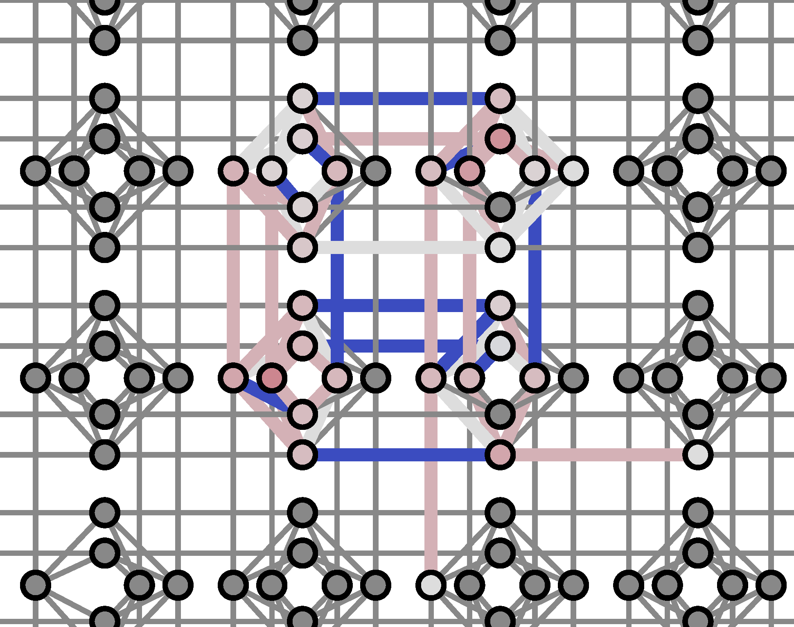
Lösung eines 4x4-Sudokus
 |  | 3 | 4
3
4 |  | 1
 | 1
1 | 2 | 3 | 4
3 | 4 | 2 | 1
4 | 3 | 1 | 2
2 | 1 | 4 | 3
Hamilton-Matrix eines 4x4-Sudokus
-2 | 4 | 0 | 0 | 0 | 0 | 0 | 0 | 0 | 0 | 0 | 0 | 0 | 0 | 0 | 0 | 0
0 | -2 | 4 | 4 | 4 | 0 | 0 | 0 | 0 | 0 | 0 | 0 | 0 | 0 | 0 | 0 | 0
0 | 0 | -2 | 0 | 0 | 0 | 4 | 0 | 0 | 4 | 0 | 0 | 0 | 0 | 0 | 4 | 0
0 | 0 | 0 | -2 | 4 | 0 | 4 | 0 | 0 | 0 | 0 | 0 | 0 | 0 | 0 | 0 | 0
0 | 0 | 0 | 0 | -2 | 4 | 4 | 0 | 4 | 0 | 0 | 0 | 4 | 0 | 0 | 0 | 0
0 | 0 | 0 | 0 | 0 | -2 | 0 | 0 | 0 | 0 | 0 | 0 | 0 | 0 | 0 | 0 | 0
0 | 0 | 0 | 0 | 0 | 0 | -2 | 4 | 0 | 0 | 0 | 0 | 0 | 4 | 0 | 0 | 0
0 | 0 | 0 | 0 | 0 | 0 | 0 | -2 | 0 | 0 | 0 | 0 | 0 | 0 | 4 | 0 | 0
0 | 0 | 0 | 0 | 0 | 0 | 0 | 0 | -2 | 4 | 0 | 0 | 4 | 0 | 0 | 0 | 0
0 | 0 | 0 | 0 | 0 | 0 | 0 | 0 | 0 | -2 | 4 | 0 | 0 | 4 | 0 | 4 | 0
0 | 0 | 0 | 0 | 0 | 0 | 0 | 0 | 0 | 0 | -2 | 0 | 0 | 0 | 0 | 0 | 0
0 | 0 | 0 | 0 | 0 | 0 | 0 | 0 | 0 | 0 | 0 | -2 | 4 | 0 | 0 | 0 | 0
0 | 0 | 0 | 0 | 0 | 0 | 0 | 0 | 0 | 0 | 0 | 0 | -2 | 4 | 0 | 4 | 0
0 | 0 | 0 | 0 | 0 | 0 | 0 | 0 | 0 | 0 | 0 | 0 | 0 | -2 | 4 | 4 | 0
0 | 0 | 0 | 0 | 0 | 0 | 0 | 0 | 0 | 0 | 0 | 0 | 0 | 0 | -2 | 0 | 4
0 | 0 | 0 | 0 | 0 | 0 | 0 | 0 | 0 | 0 | 0 | 0 | 0 | 0 | 0 | -2 | 4
0 | 0 | 0 | 0 | 0 | 0 | 0 | 0 | 0 | 0 | 0 | 0 | 0 | 0 | 0 | 0 | -2
Embedding

Slide 15
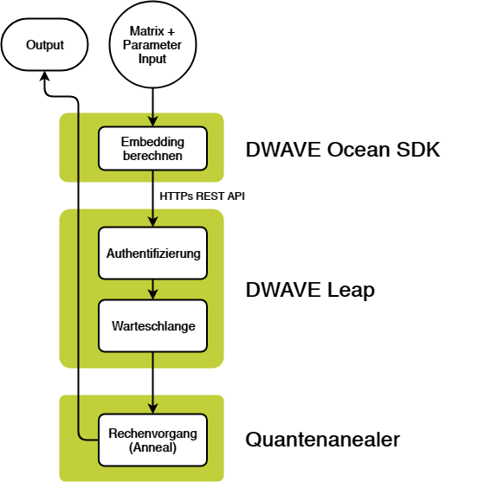
technische Umsetzung
-8.000000 171 [0 0 1 0 1 0 0 0 0 0 0 1 0 1 0 0]
-8.000000 6794 [0 1 0 0 0 0 0 1 1 0 0 0 0 0 1 0]
-6.000000 2 [1 0 0 0 1 0 0 0 0 0 0 1 0 1 0 0]
-6.000000 115 [0 0 0 1 0 0 0 0 1 0 0 0 0 0 1 0]
-6.000000 7 [0 0 1 0 0 0 0 0 0 0 0 1 0 1 0 0]
-6.000000 10 [1 0 0 0 0 0 0 1 0 1 0 0 0 0 0 0]
-6.000000 6 [1 0 1 0 0 0 0 0 0 0 0 1 0 1 0 0]
-6.000000 12 [1 0 0 0 0 0 0 1 0 1 0 0 0 0 1 0]
-6.000000 128 [0 1 0 0 0 0 0 1 0 0 0 0 0 0 1 0]
-6.000000 12 [0 0 1 0 1 0 0 0 0 0 0 1 0 0 0 0]
-6.000000 26 [0 0 0 1 1 0 0 0 0 0 0 1 0 1 0 0]
-6.000000 1 [0 0 1 0 1 0 0 0 0 0 0 0 0 1 0 0]
-6.000000 16 [0 0 0 1 1 0 0 0 0 0 0 0 0 1 0 0]
-6.000000 154 [0 0 0 1 0 1 0 0 0 0 0 0 0 0 1 0]
-6.000000 12 [1 0 0 0 0 0 0 0 0 0 0 1 0 1 0 0]
-6.000000 51 [1 1 0 0 0 0 0 1 0 0 0 0 0 0 1 0]
-6.000000 11 [0 0 0 0 1 0 0 0 0 0 0 1 0 1 0 0]
-6.000000 25 [1 0 0 0 0 0 1 0 0 0 0 1 0 1 0 0]
-6.000000 87 [0 0 0 1 0 1 0 0 1 0 0 0 0 0 1 0]
-6.000000 34 [1 0 0 0 0 0 0 1 0 0 0 0 0 0 1 0]
-6.000000 1 [0 0 1 1 1 0 0 0 0 0 0 0 0 1 0 0]
-6.000000 3 [0 0 1 1 1 0 0 0 0 0 0 1 0 1 0 0]
-6.000000 56 [1 0 0 0 0 0 1 0 0 0 0 0 0 1 0 0]
-6.000000 101 [0 0 0 1 0 0 0 1 1 0 0 0 0 0 1 0]
-6.000000 4 [1 0 1 0 1 0 0 0 0 0 0 1 0 1 0 0]
-6.000000 131 [0 1 0 0 0 0 0 1 0 0 0 0 1 0 1 0]
-6.000000 53 [0 0 1 0 0 0 0 0 0 0 0 1 1 0 0 0]
-6.000000 87 [0 1 0 1 0 0 0 0 1 0 0 0 0 0 1 0]
-6.000000 44 [1 1 0 0 0 0 0 1 1 0 0 0 0 0 1 0]
-6.000000 90 [0 1 0 0 0 0 0 0 1 0 0 0 0 0 1 0]
-6.000000 31 [0 0 0 0 0 0 0 1 1 0 0 0 0 0 1 0]
-6.000000 28 [0 0 1 0 1 0 0 0 0 0 0 1 1 0 0 0]
-6.000000 30 [0 0 0 0 0 1 0 0 0 0 0 1 1 0 0 0]
Notes:
JT
Matrix -> Embedding -> Dwave Leap -> Berechnung (sehr oft) -> Results

Slide 16
„Dekodieren“ der Ergebnisse
Energie
Anzahl
Wert der Qubits
-8.000000 6794 [0 1 0 0 0 0 0 1 1 0 0 0 0 0 1 0]
a b c d e f g h i j k l m n o p
a | b | c | d
e | f | g | h
i | j | k | l
m | n | o | p
0 | 1 | 0 | 0
0 | 0 | 0 | 1
1 | 0 | 0 | 0
0 | 0 | 1 | 0
Notes:
wie sieht ein Ergebnis aus?
Übertragung von 0 und 1 auf Schachfeld (Damen)

Slide 17
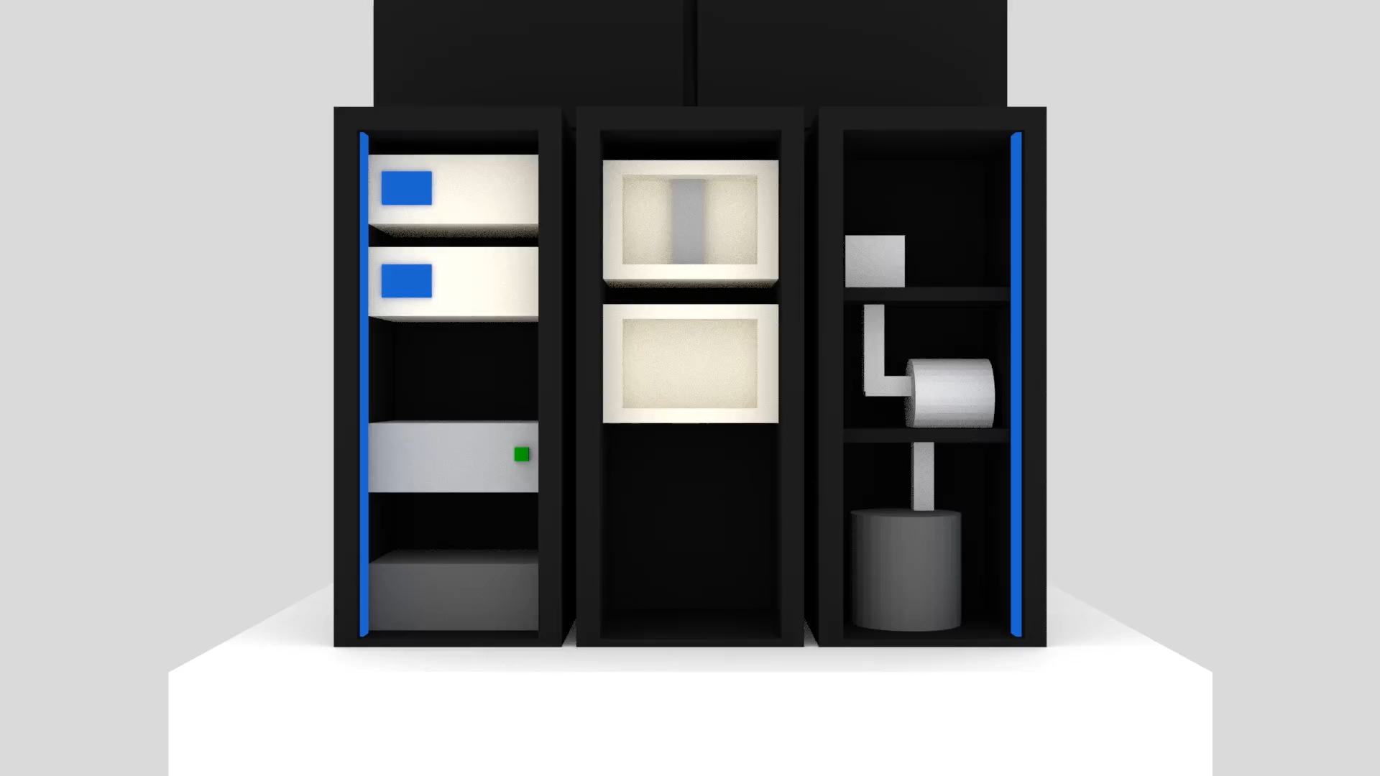

Zu unserer Website:
www.domspatzen-quantum.de
Notes:
Qc specs
15 mk Heliumkühlung

Slide 18
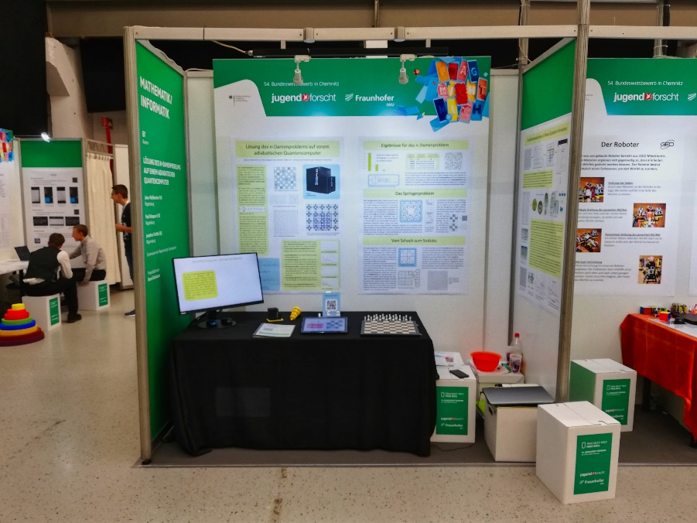
Jugend forscht Wettbewerb
Regionalwettbewerb
12150 Teilnehmer (2019)
Landeswettbewerb (Bayern)
Präsentationsstand:
Bundesfinale
Themengebiete:
Arbeitswelt
Biologie
Chemie
Geo- und Raumwissenschaften
Mathematik / Informatik
bis 14 : Schüler experimentieren
15 – 20 : Jugend forscht
Physik
Technik
Notes:
Mit diesem Projekt bei JuFo
JuFo System erklären
Jufo Teilnehmer, Stand, Jurygespräch, Wie stellt man das Projekt vor, Schüex, Ebenen, Themen

Slide 19
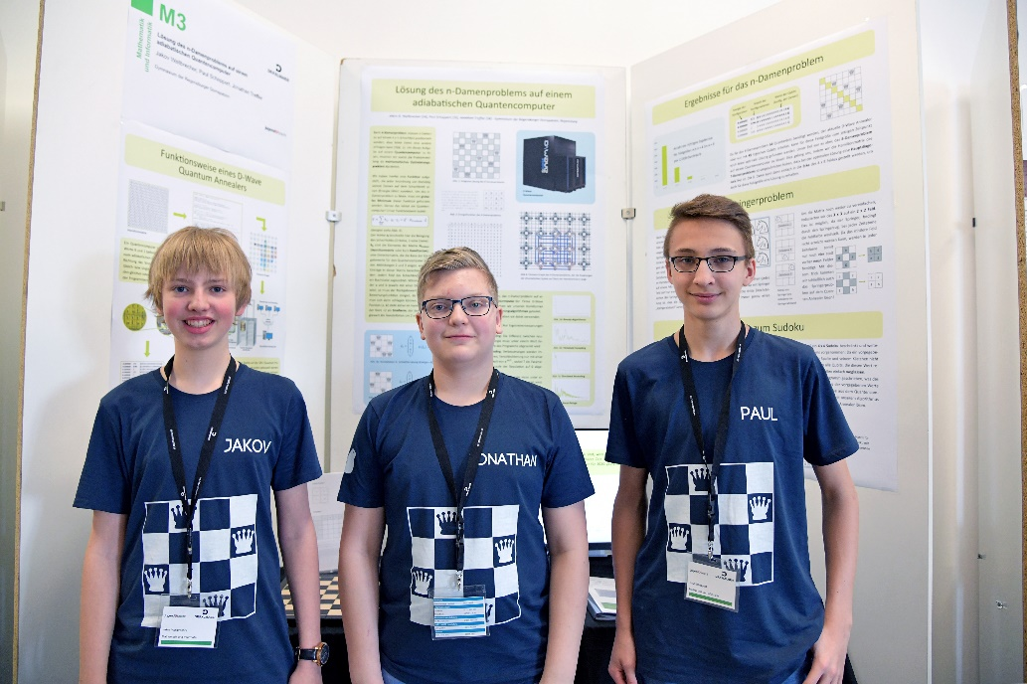


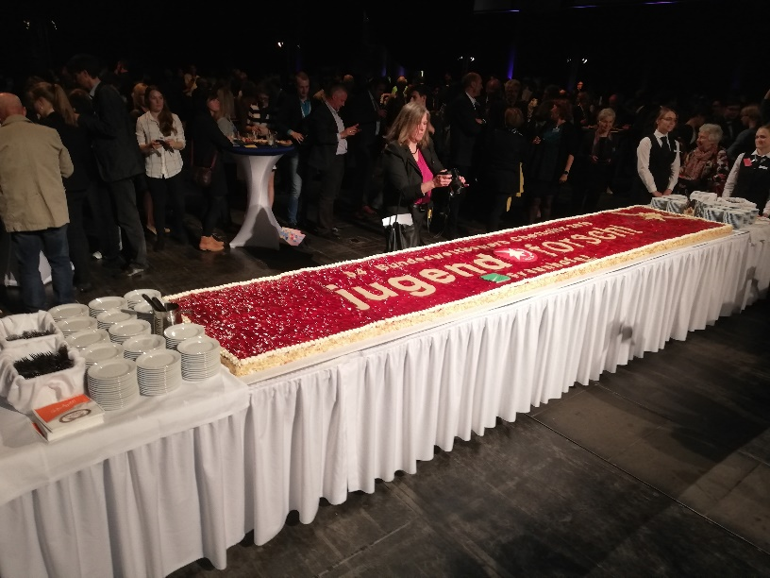
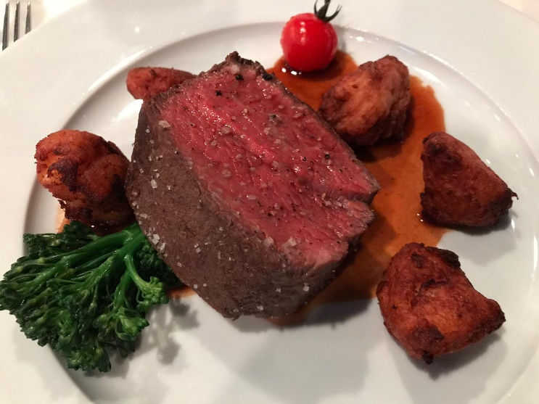
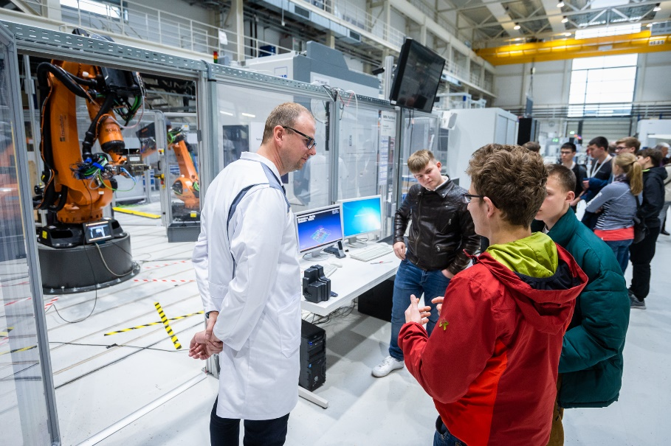


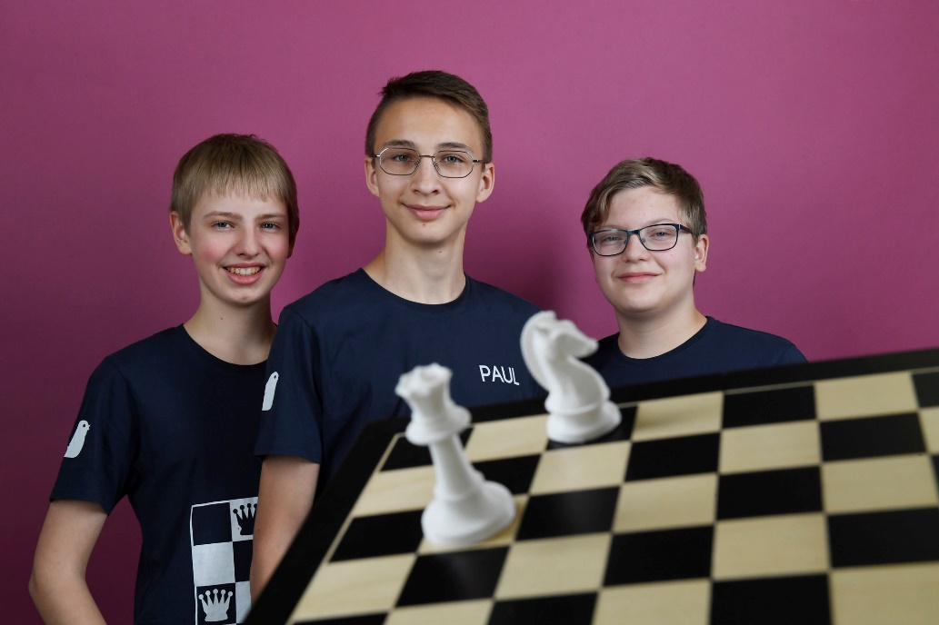
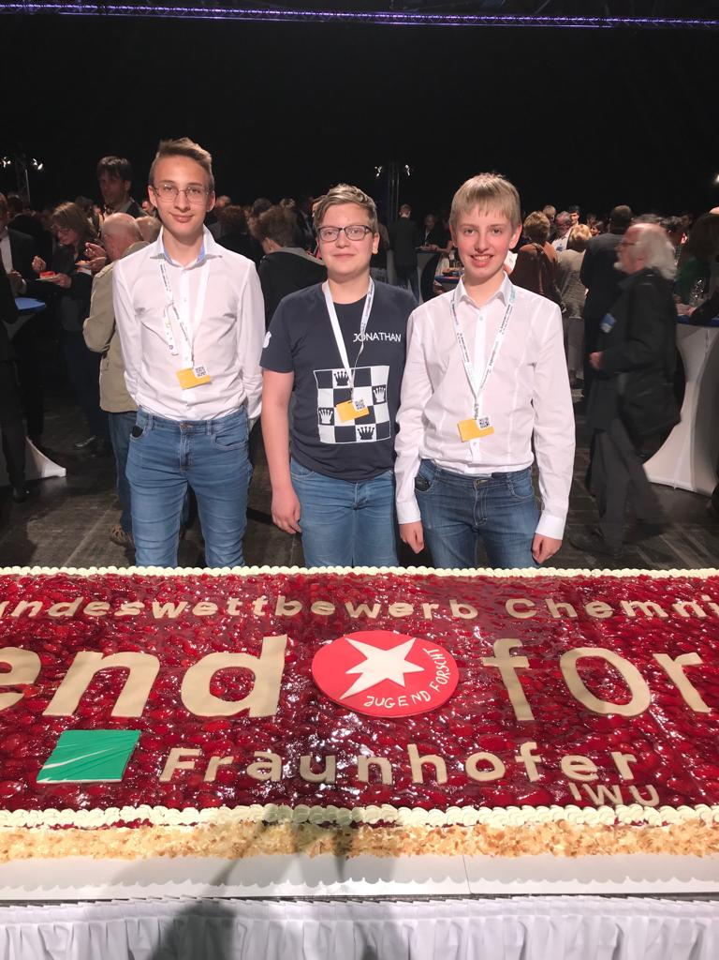
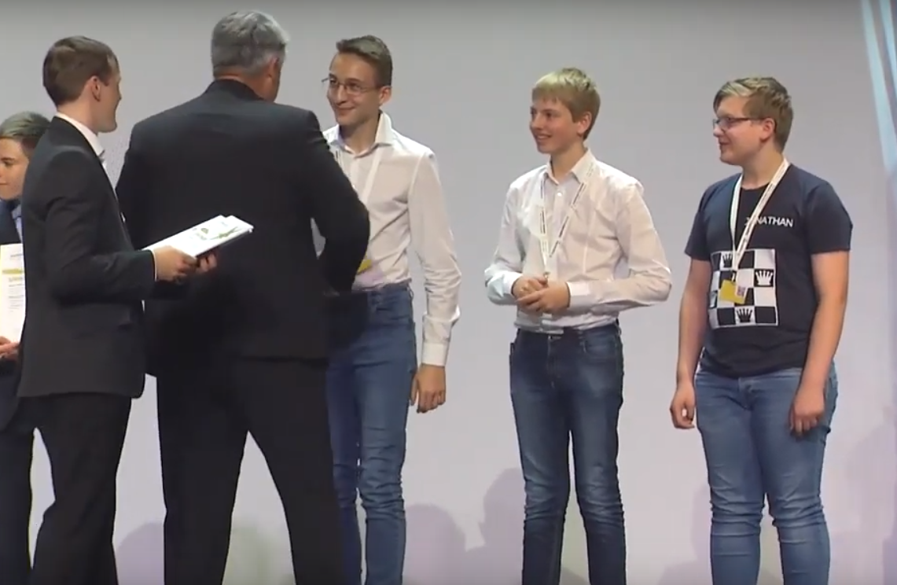
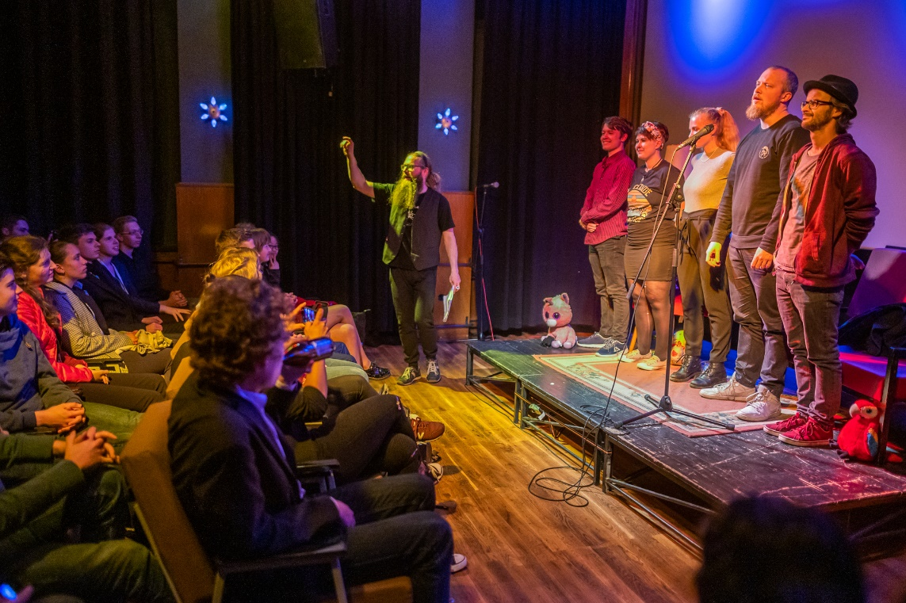
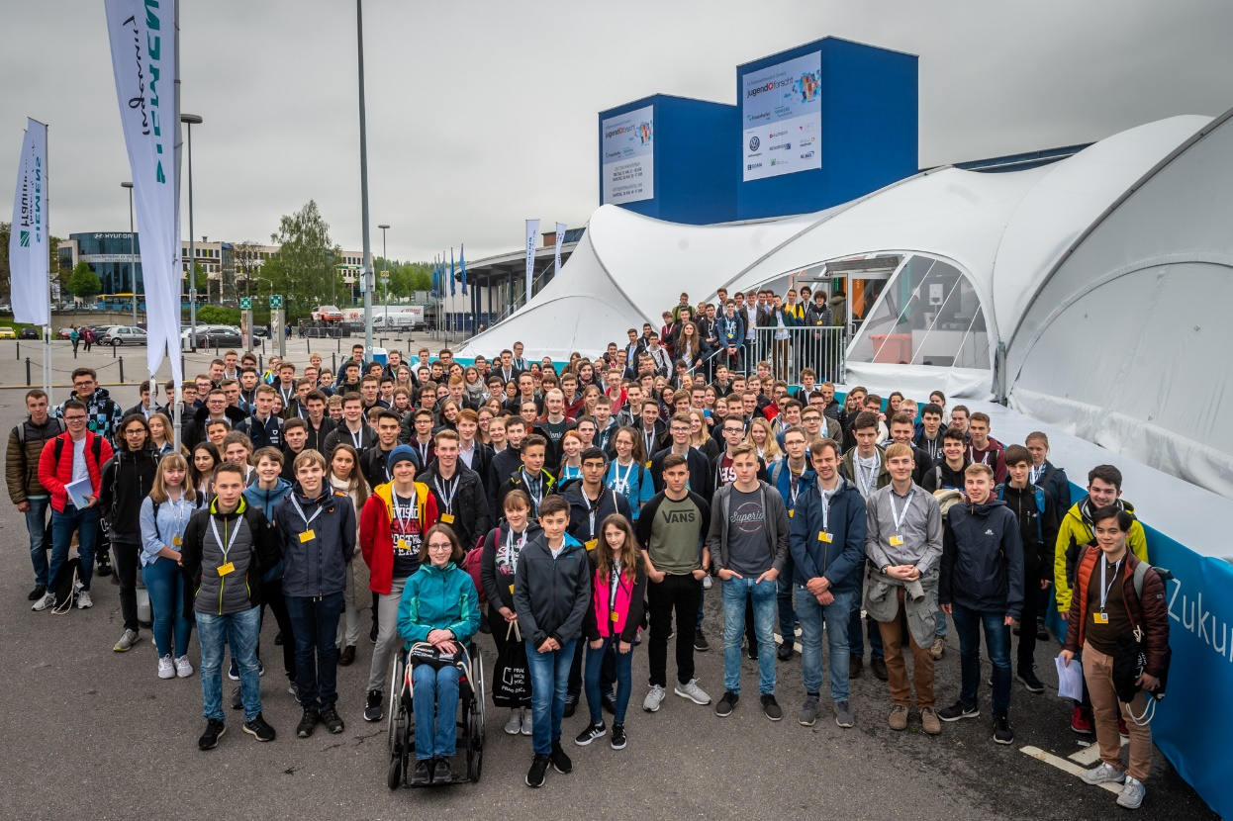

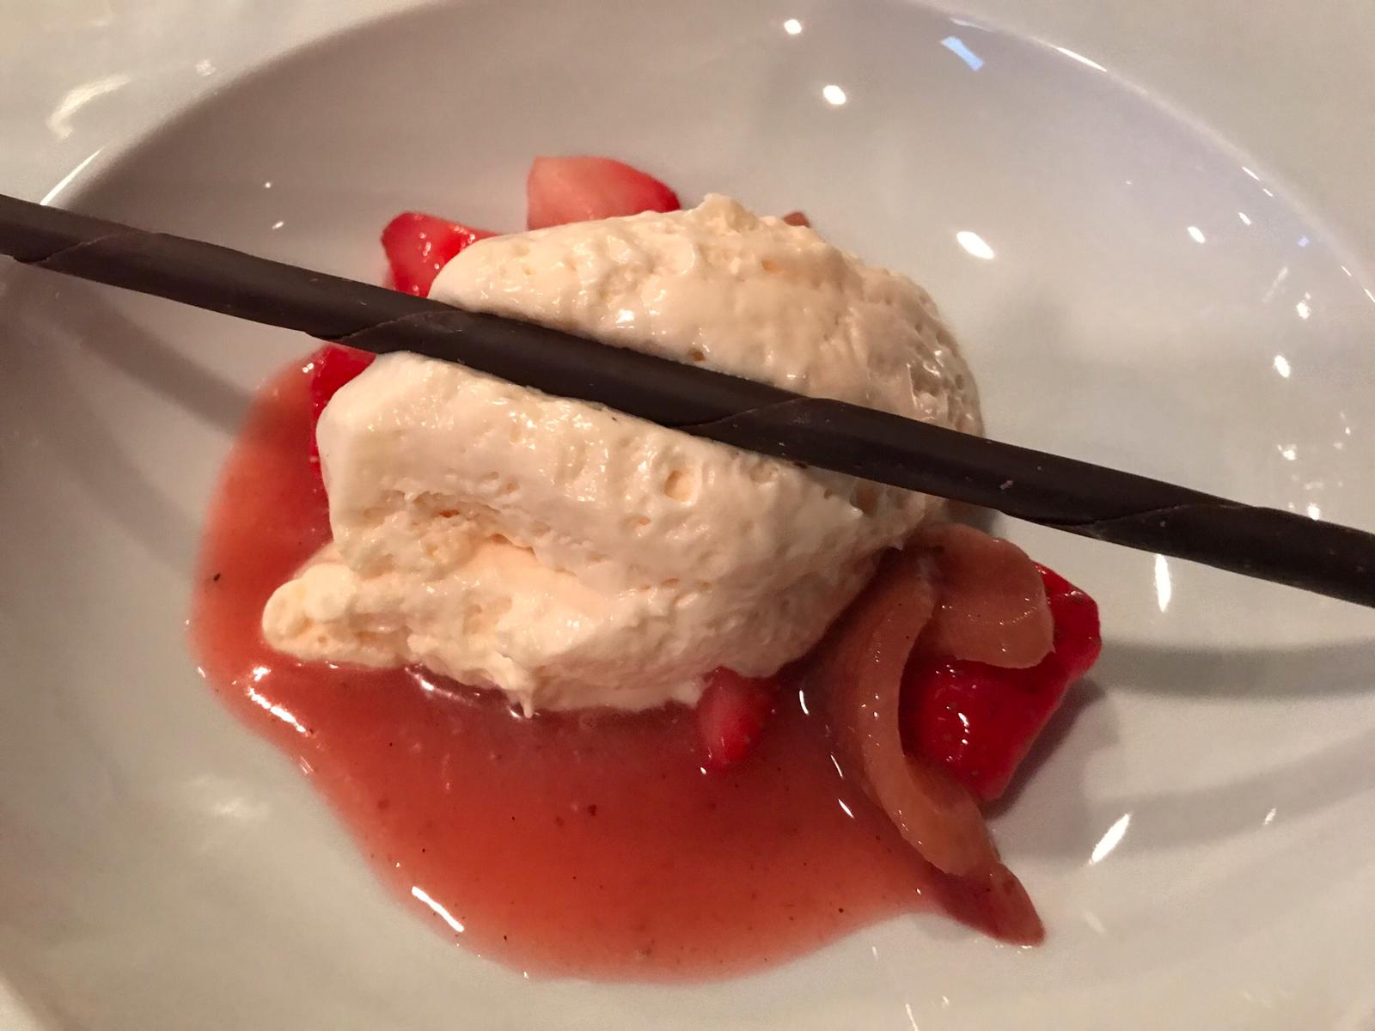
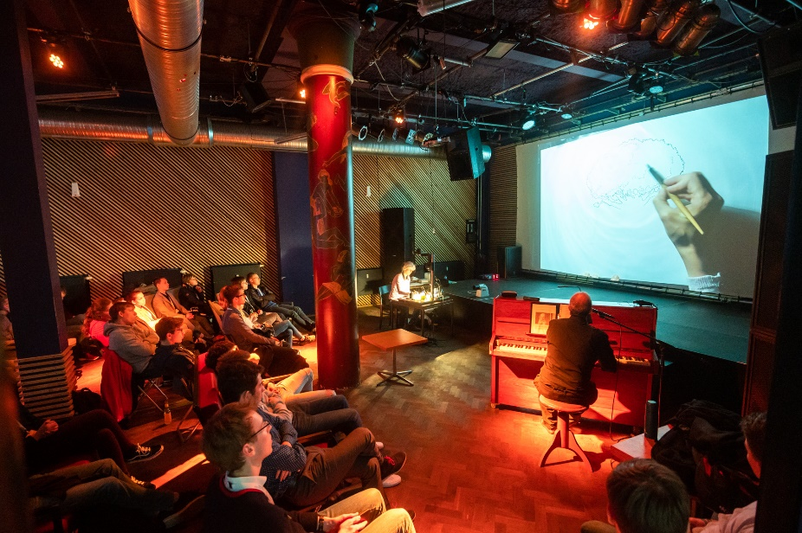
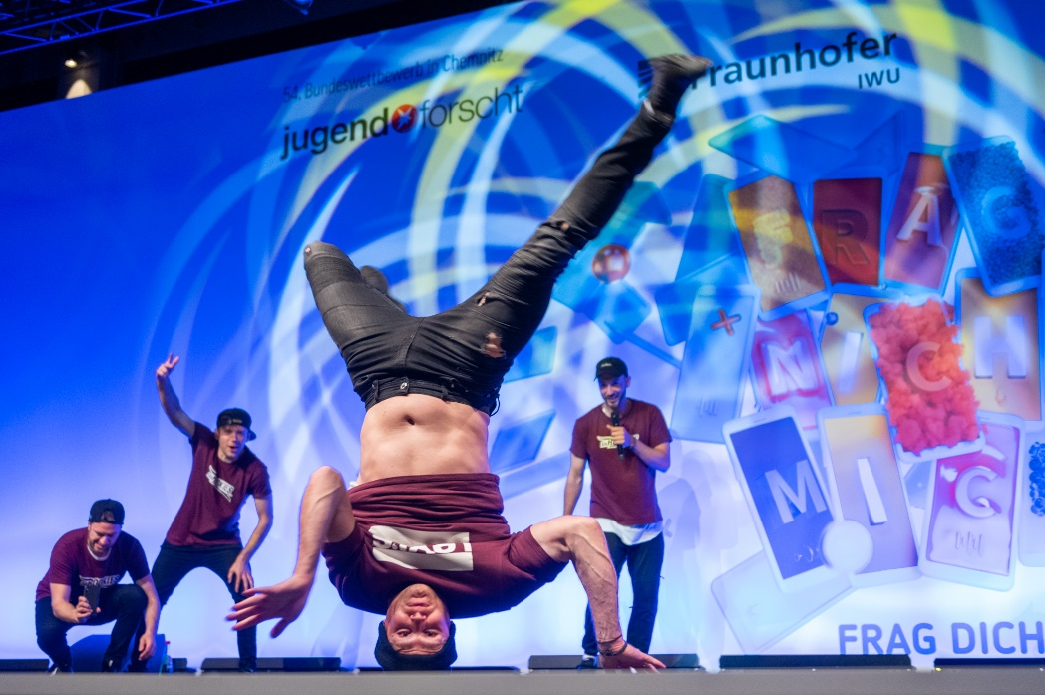
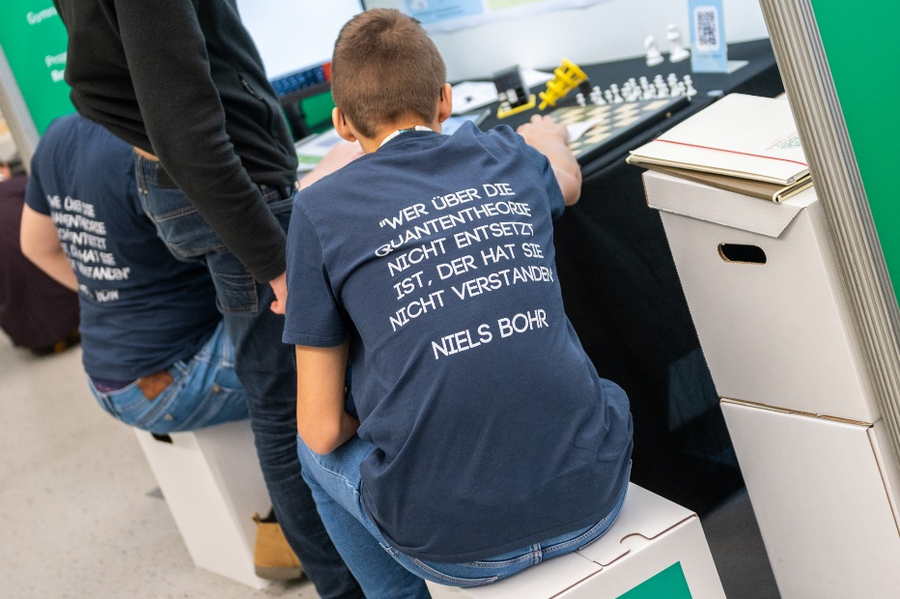
Jugend forscht Wettbewerb
Neumarkt, Vilsbiburg, Chemnitz
Notes:
Spannendes Rahmenprogramm
Essen, Erdbeerkuchen
Erzielte Preise: 1. Regional, Land; 4. Bund Sonderpreis für eine Arbeit z.T. Zukunftsorientierte Technologien
Merkel, Vorträge bei Krones, MPQ, ISC

Slide 20
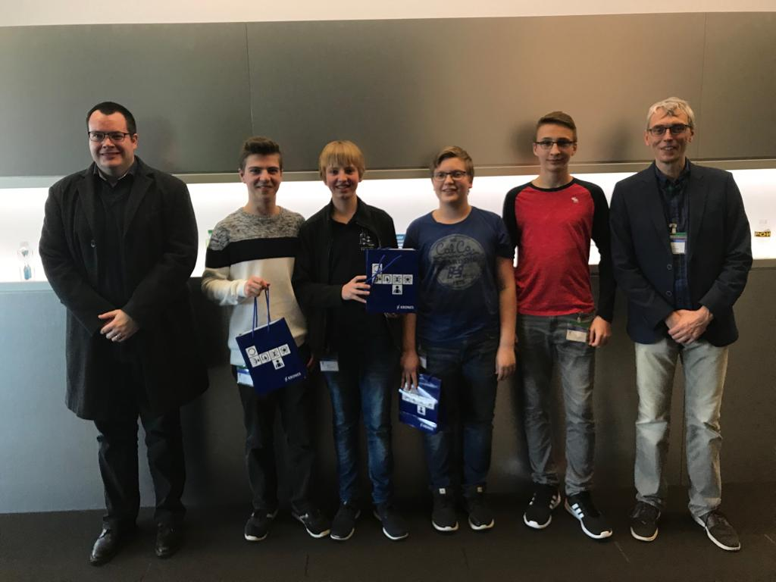
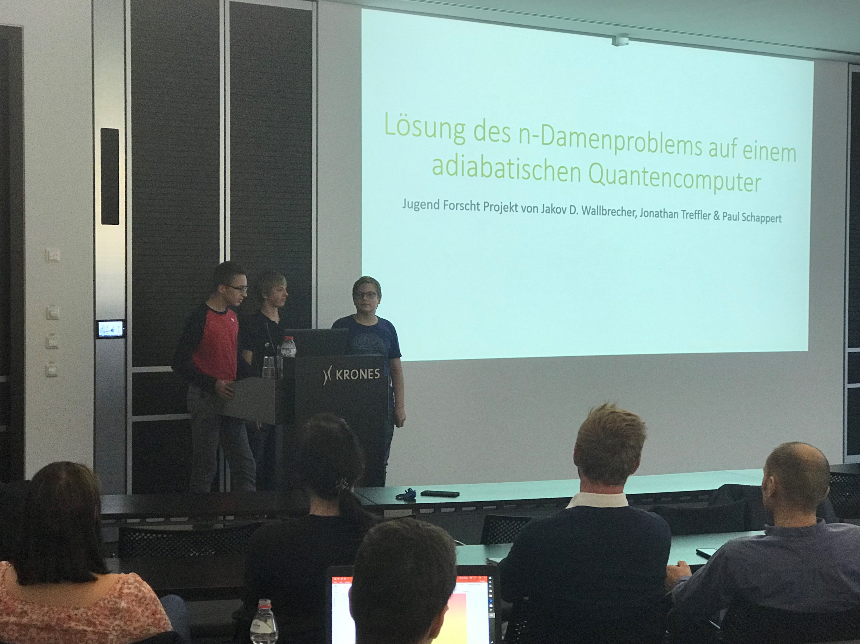
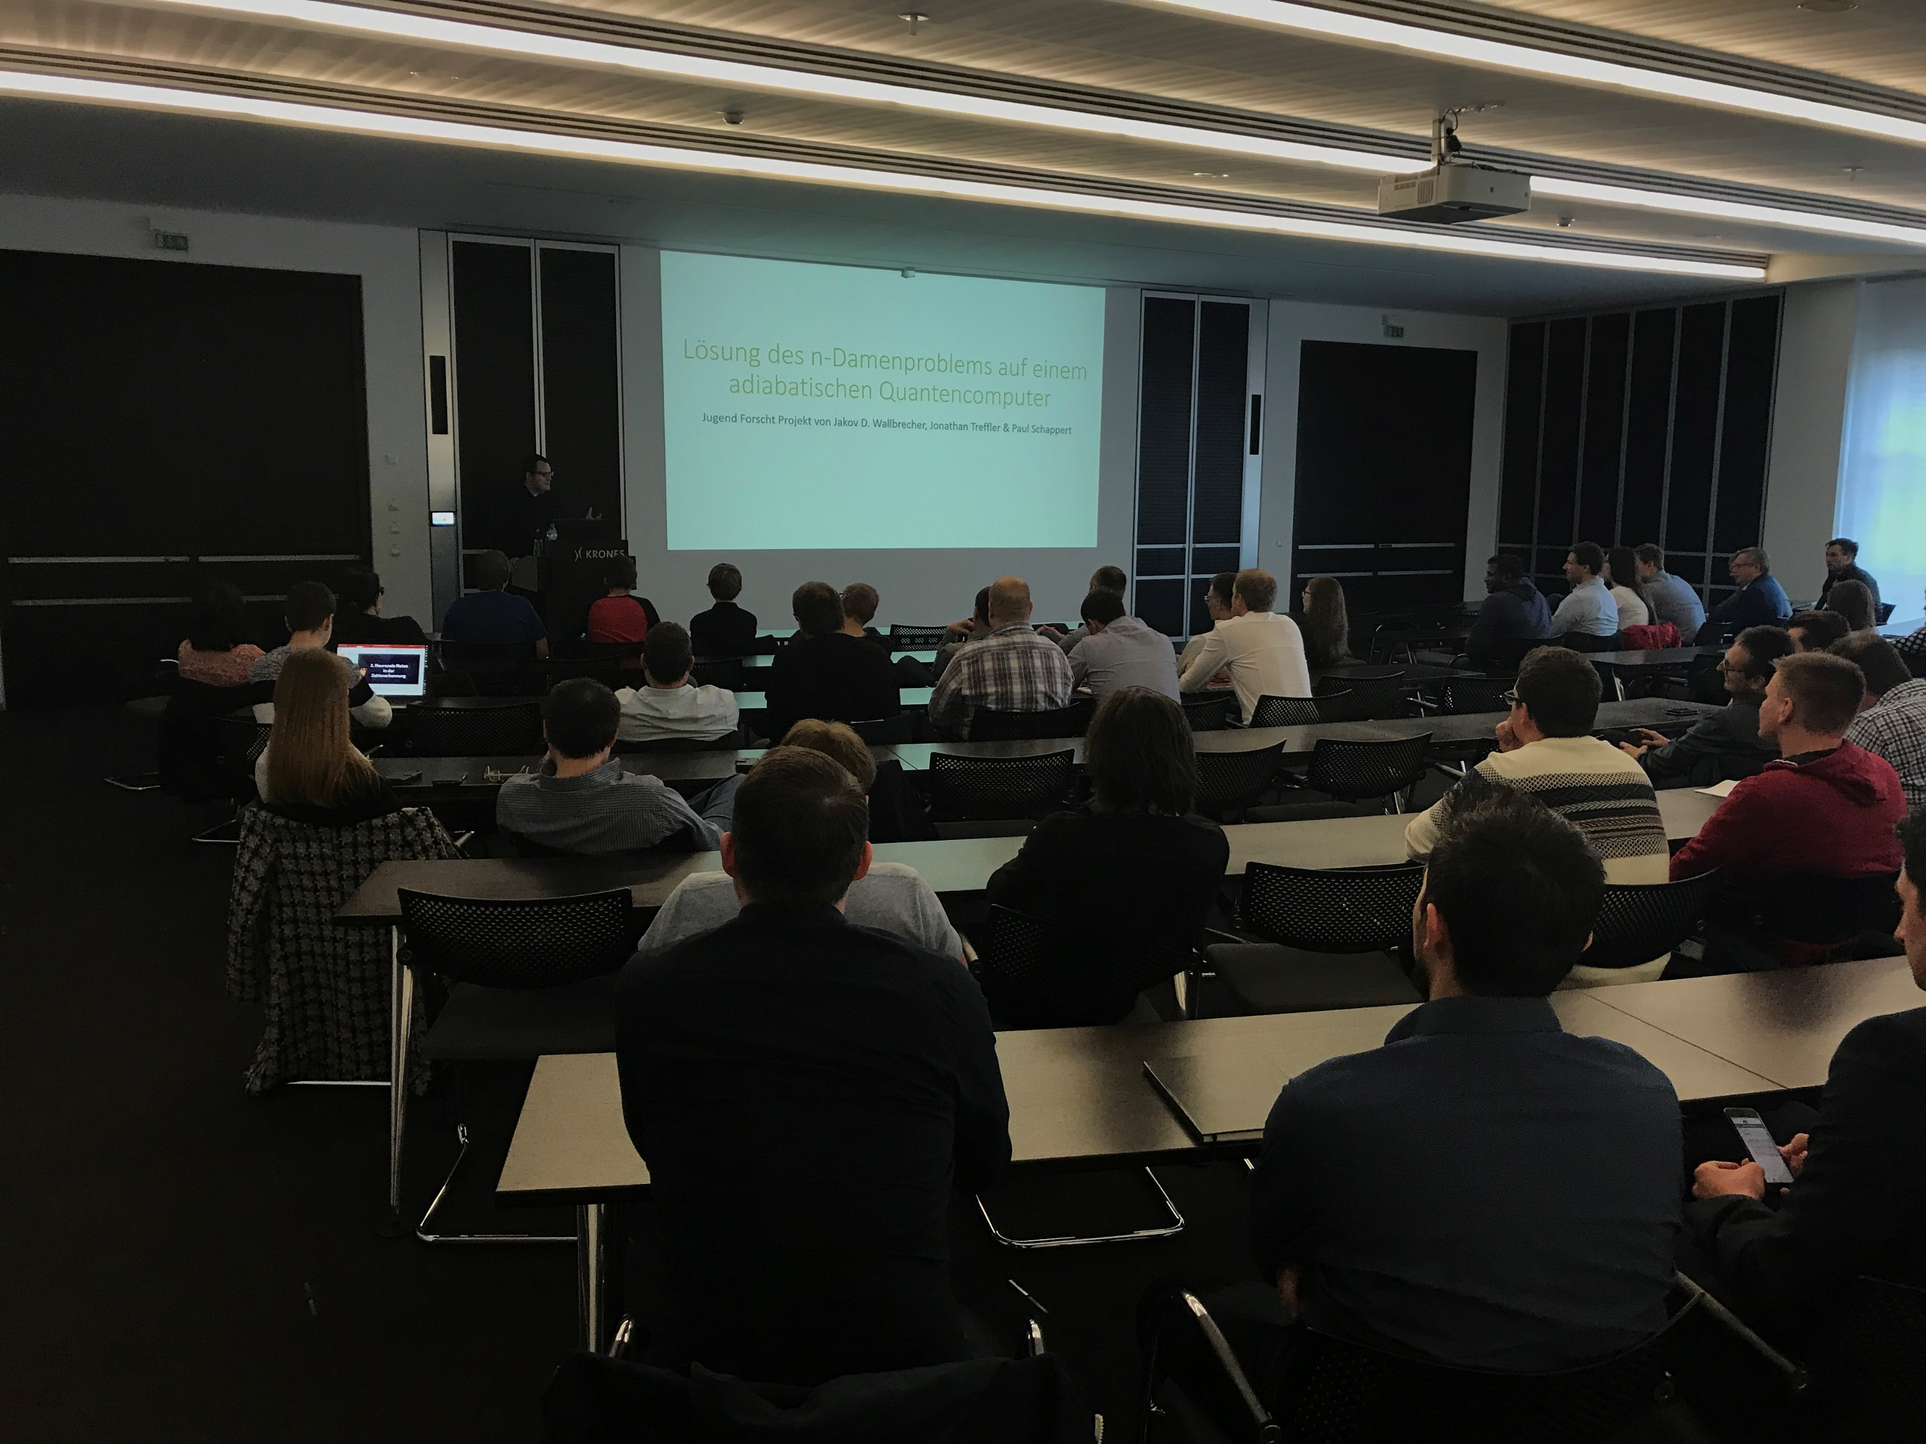
Vortrag Krones AG
Neutraubling

Slide 21
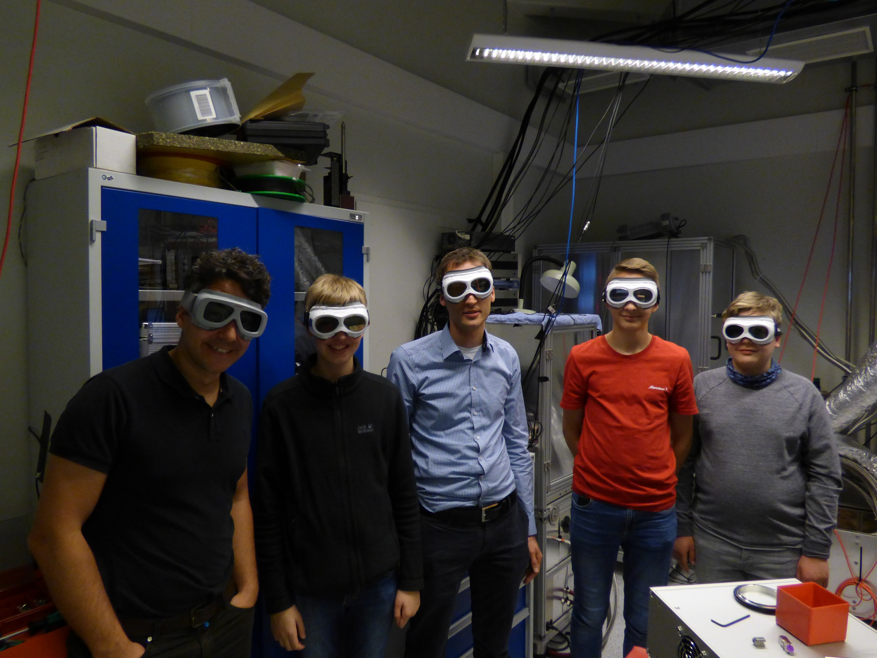
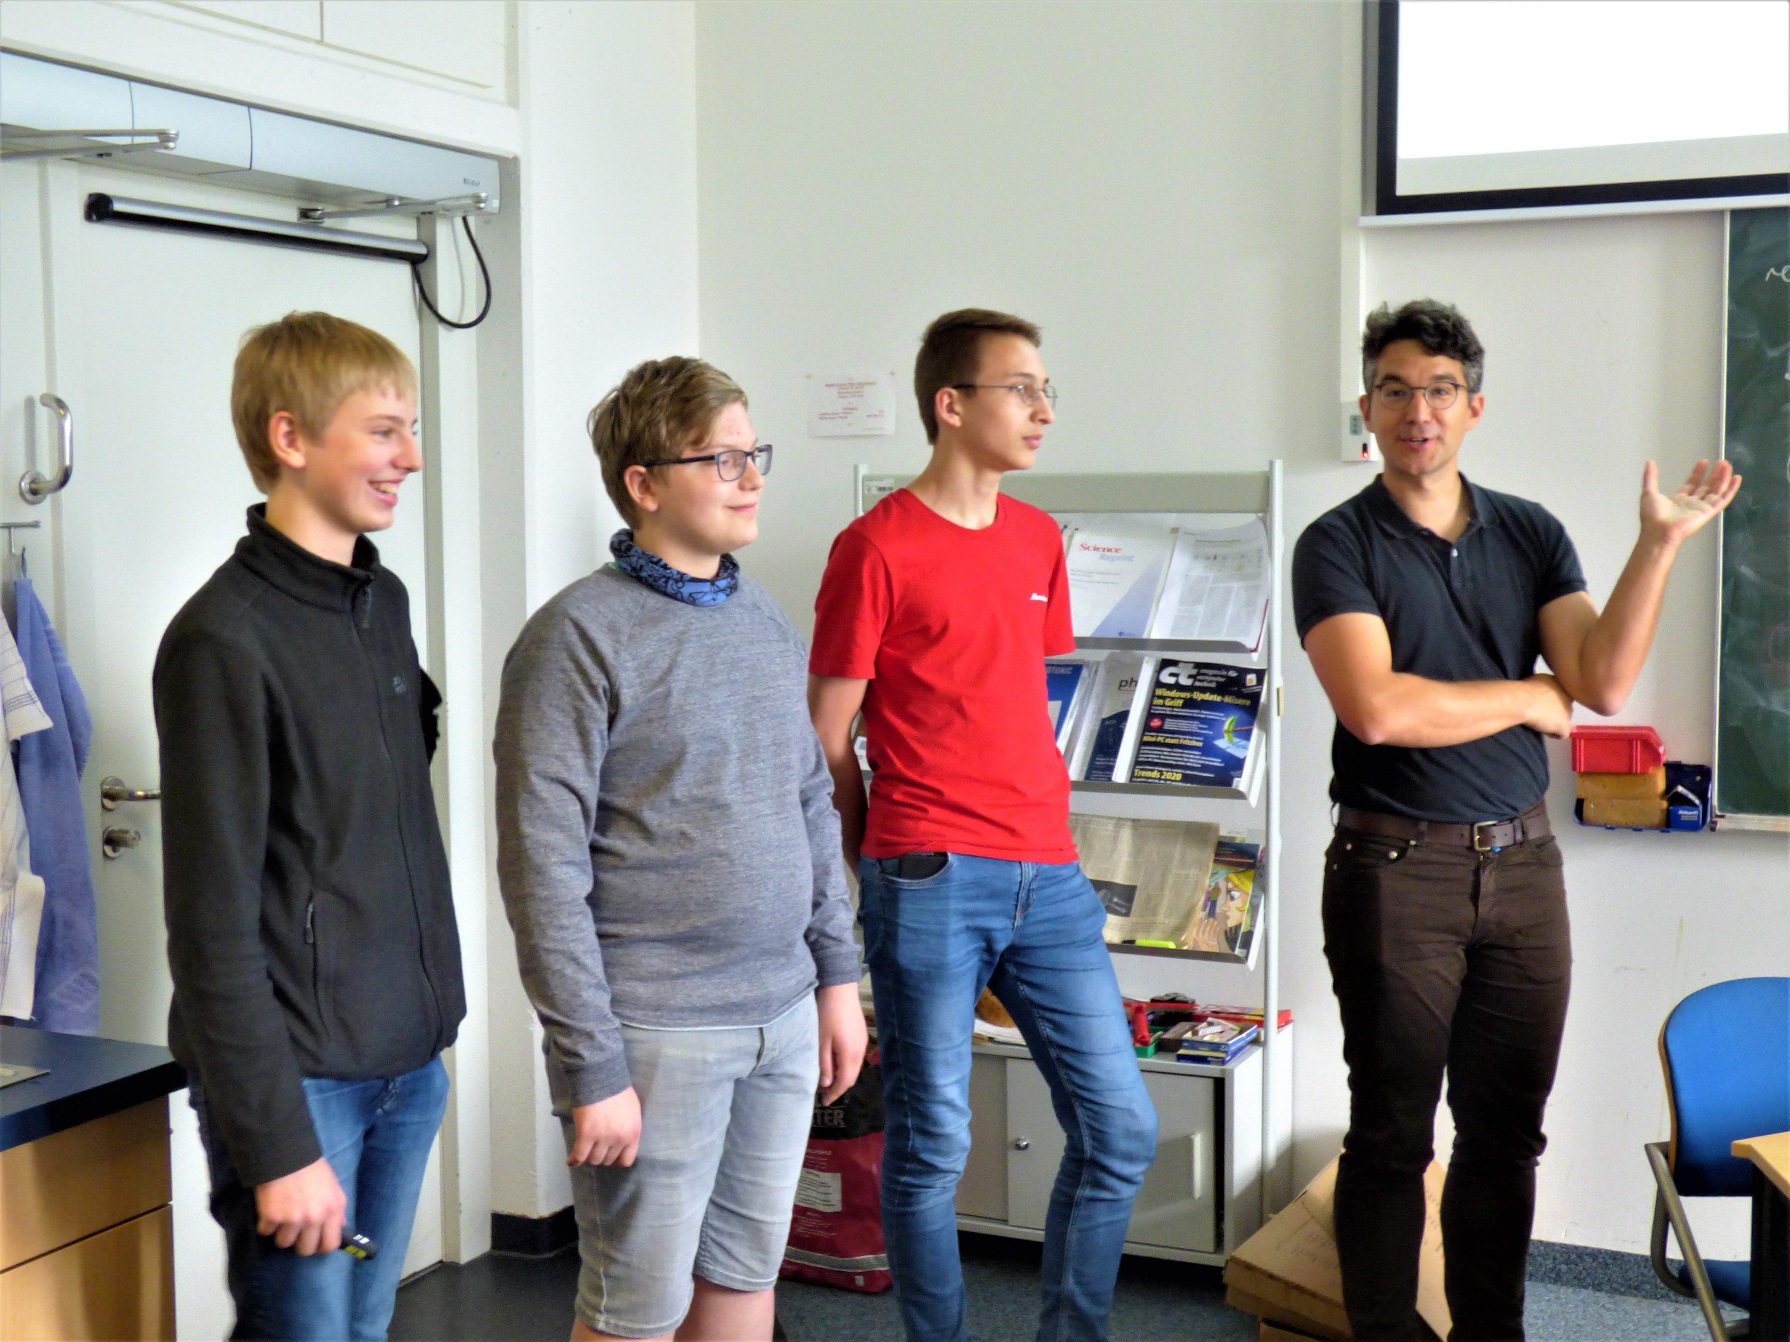
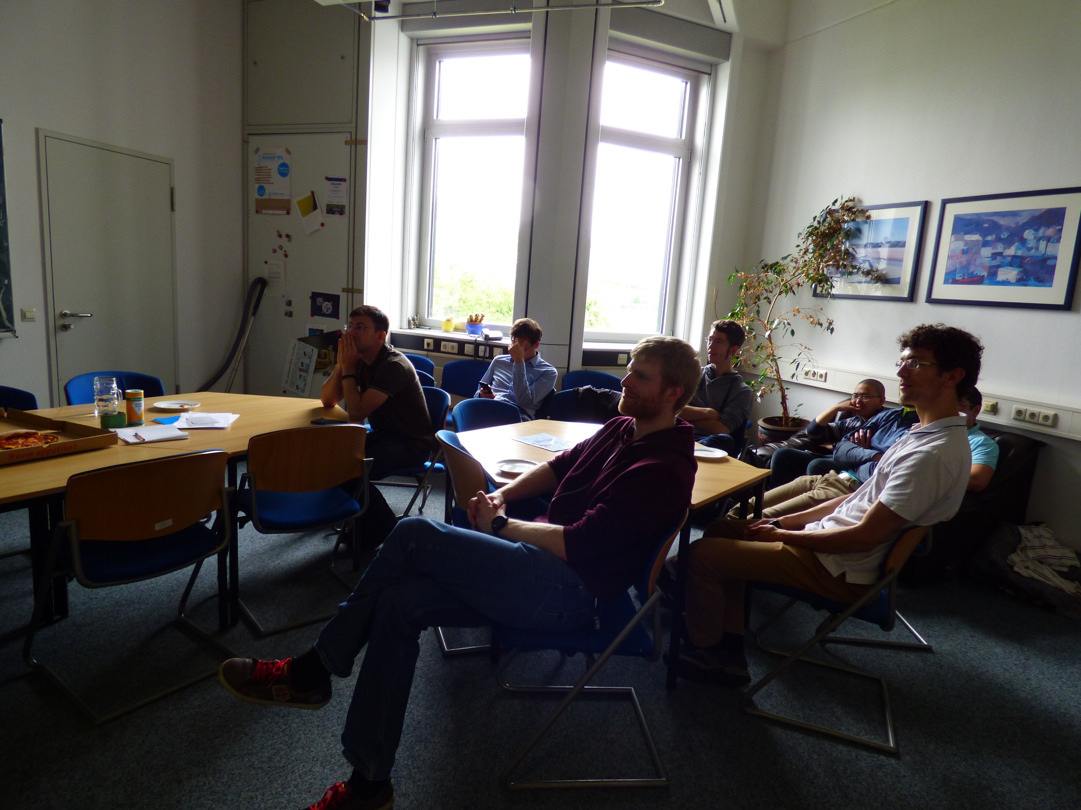
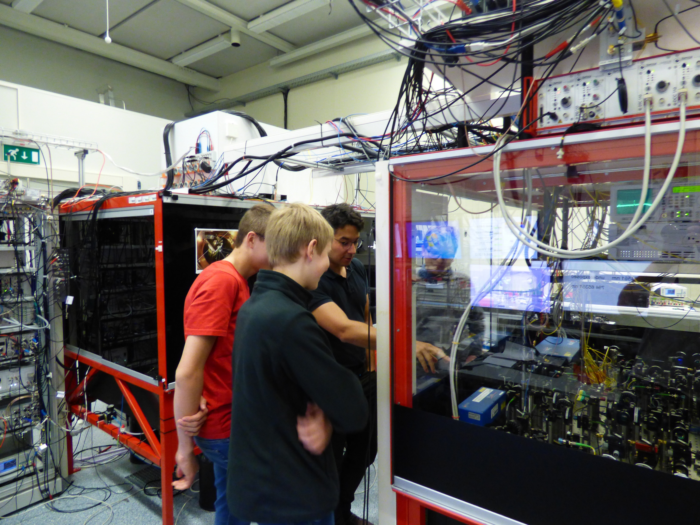
Vortrag MPQ München

Slide 22
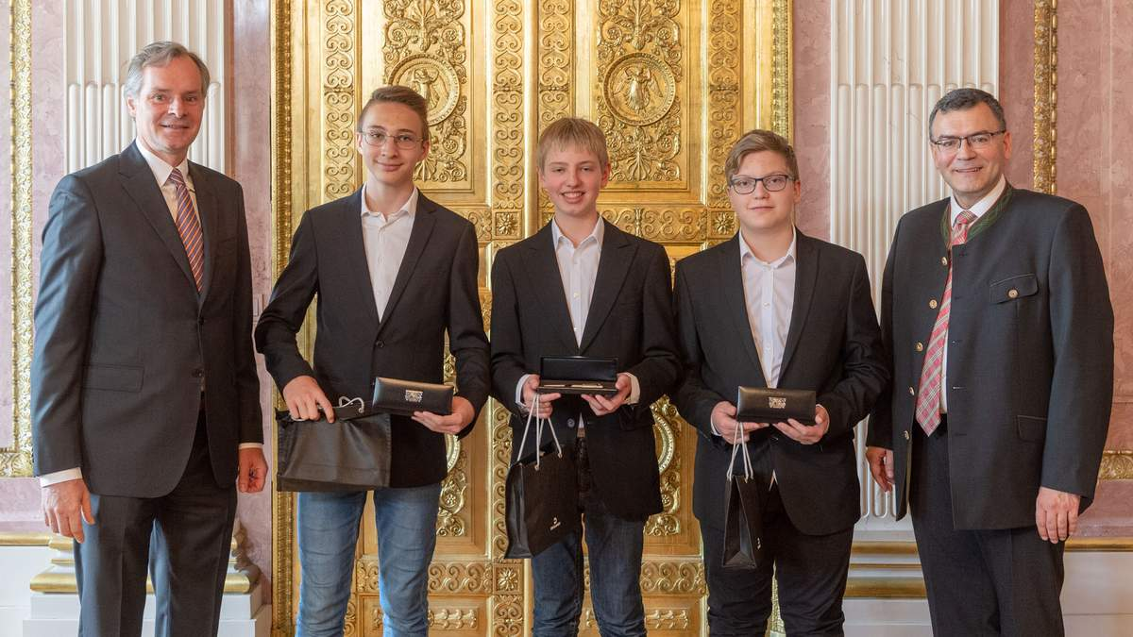
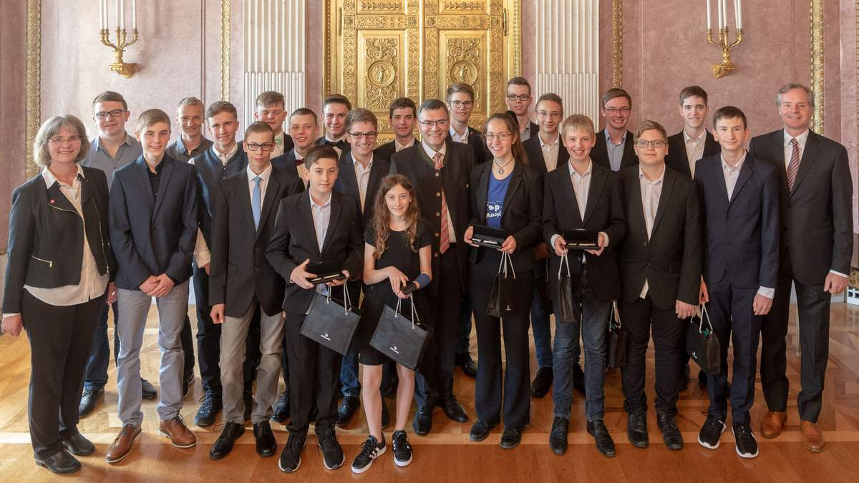
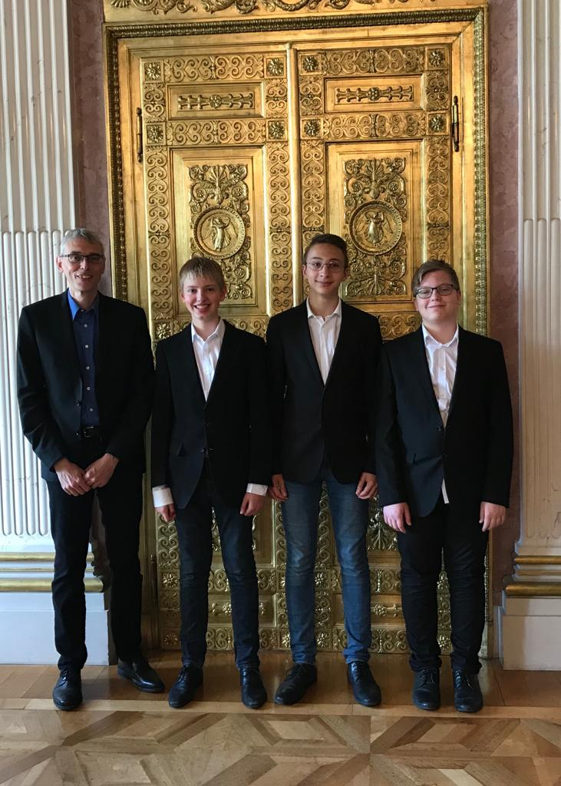
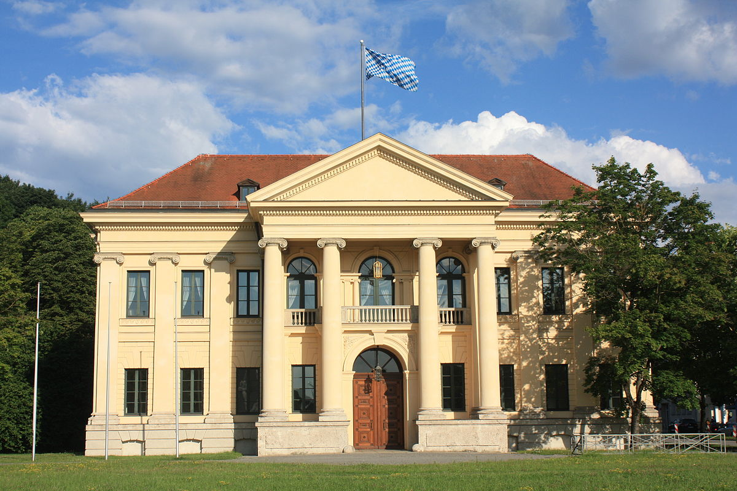
Staatsempfang München

Slide 23
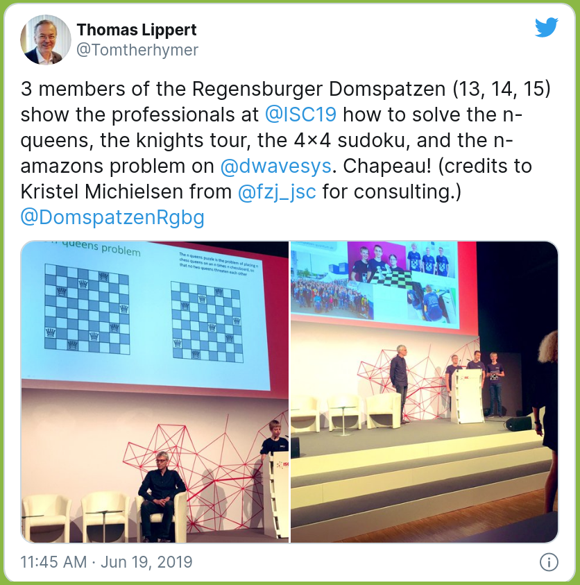
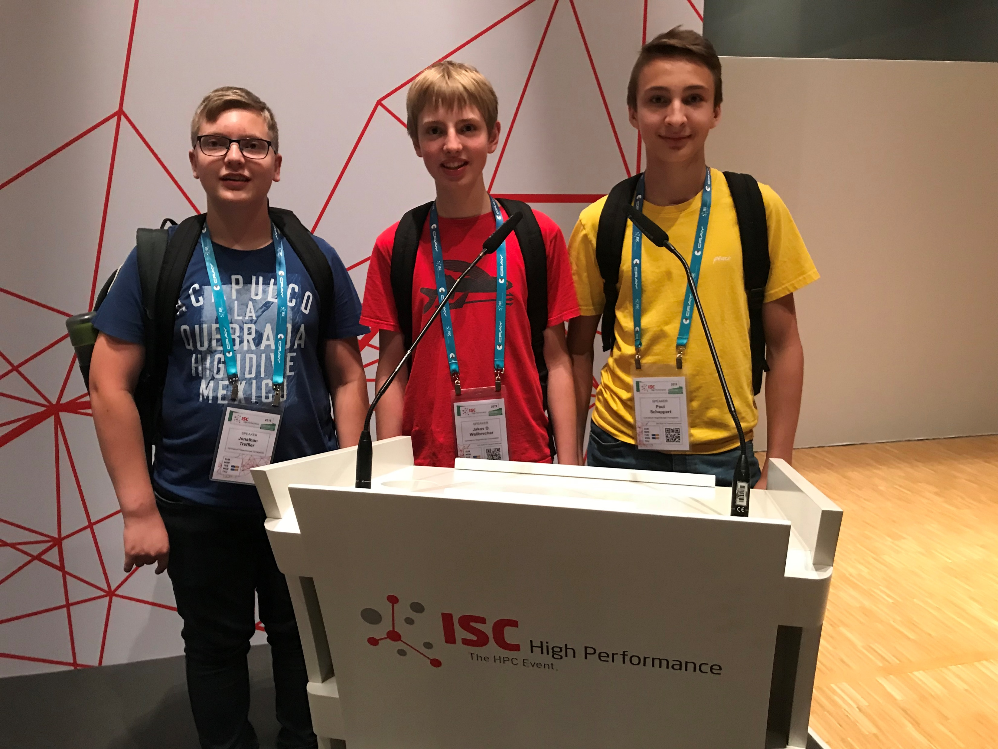
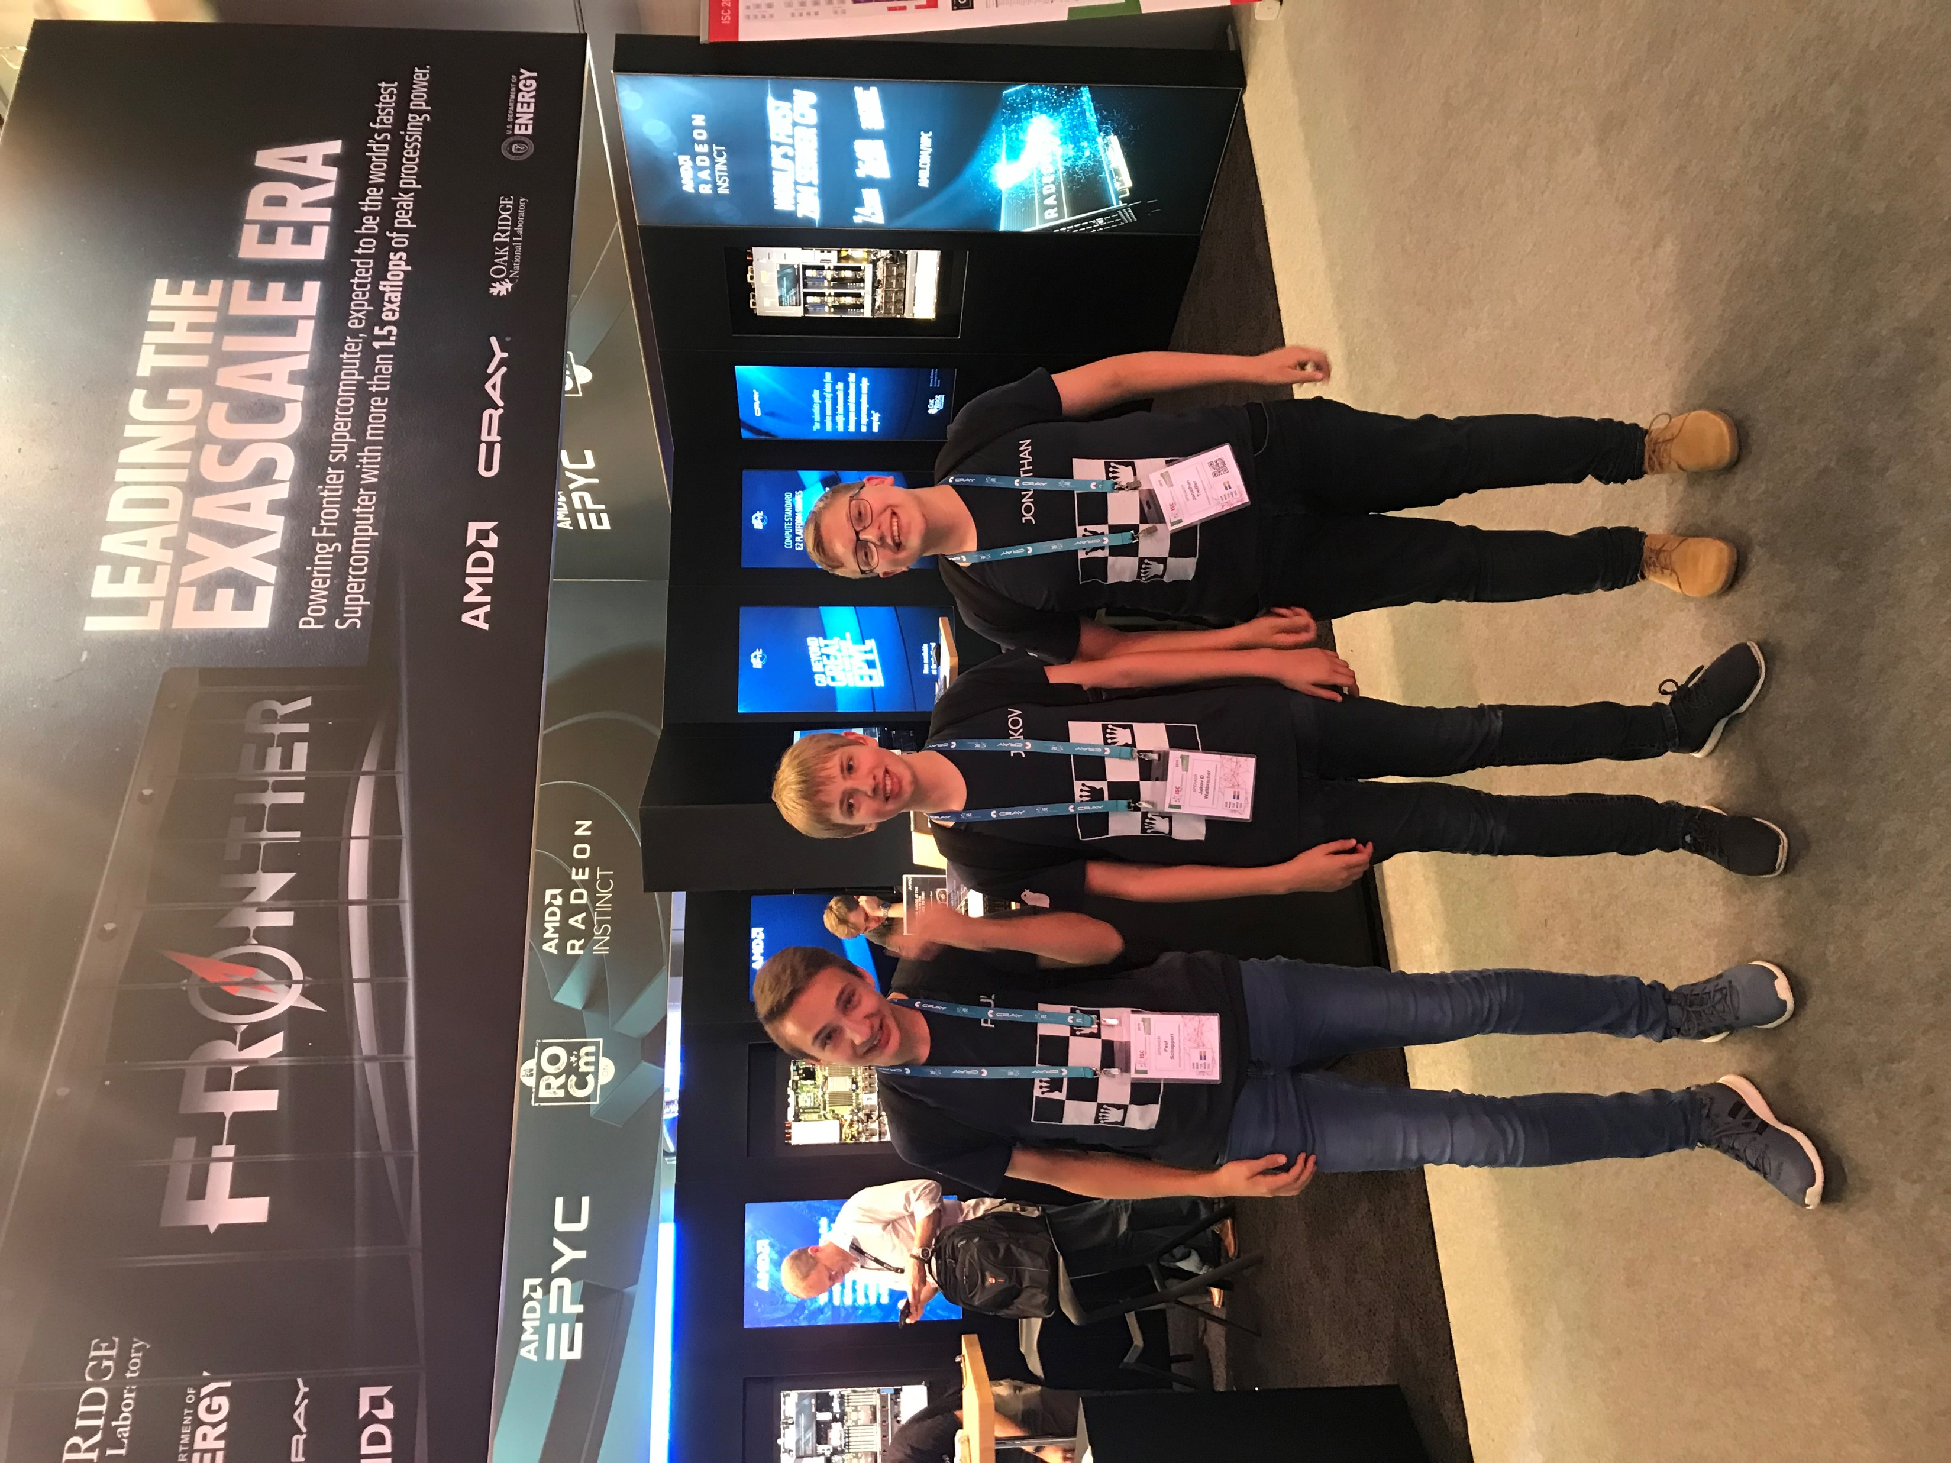
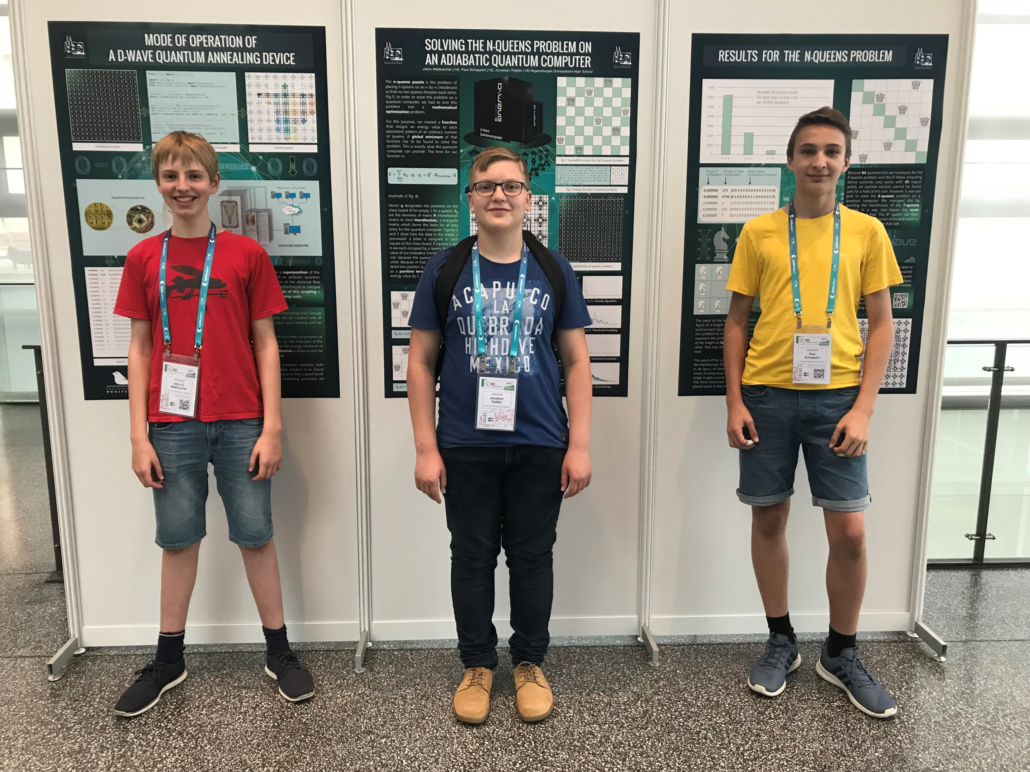
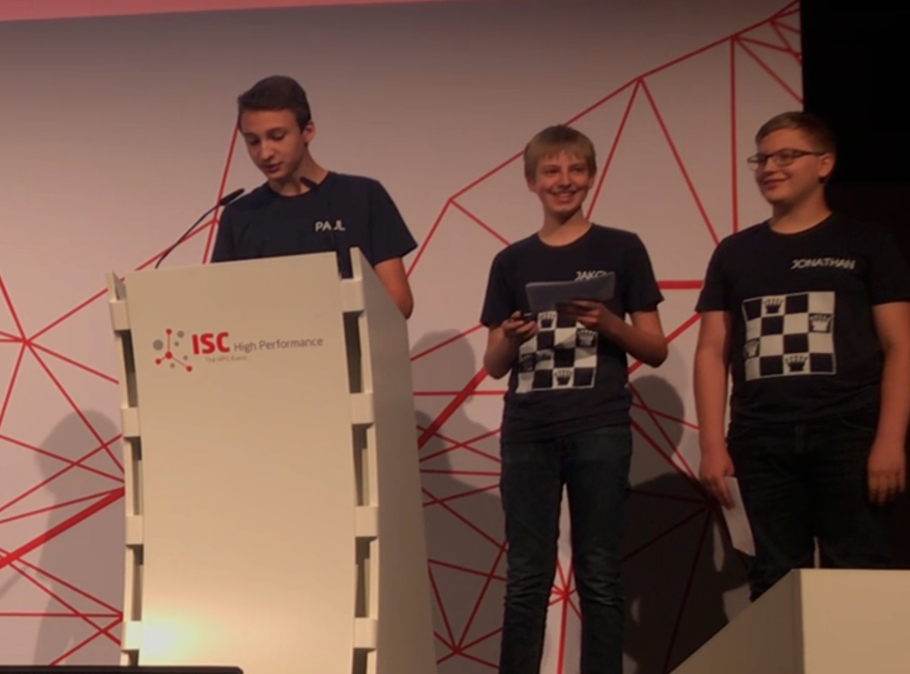
Vortrag ISC Frankfurt

Slide 24
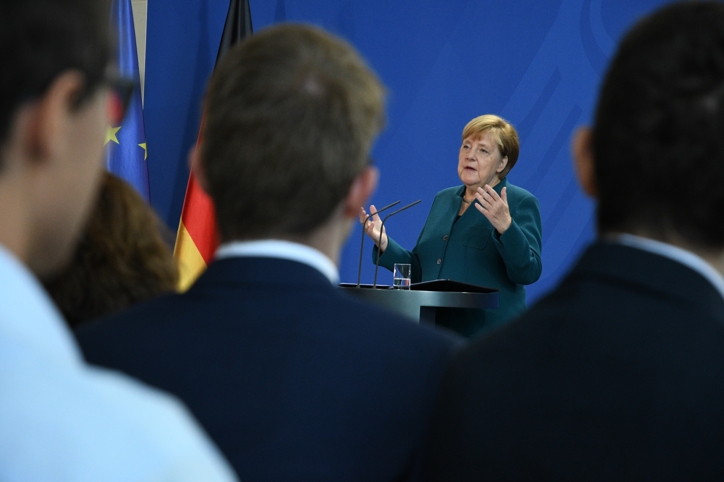
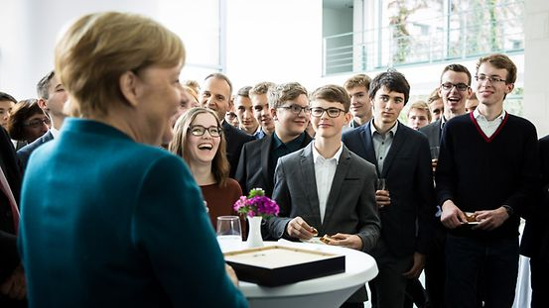
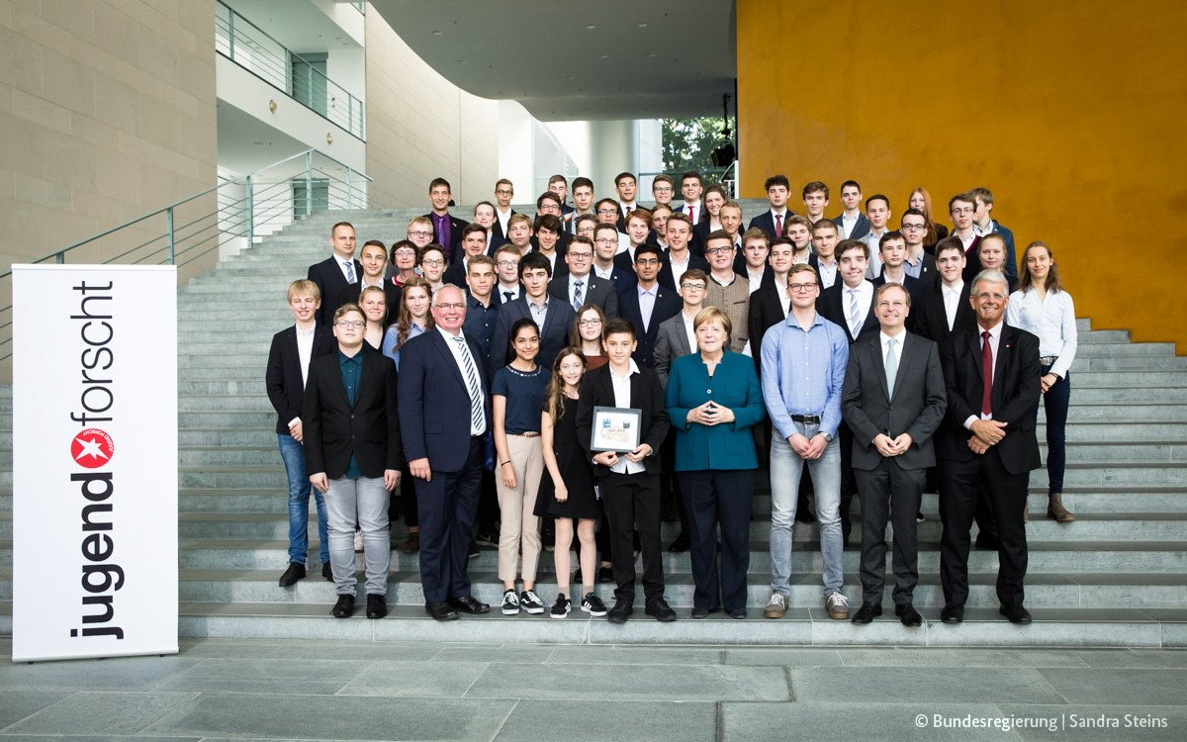
Empfang Bundeskanzlerin Berlin

Slide 25
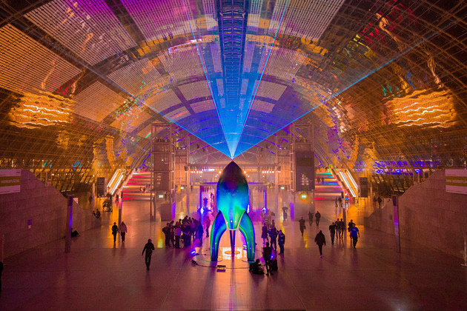
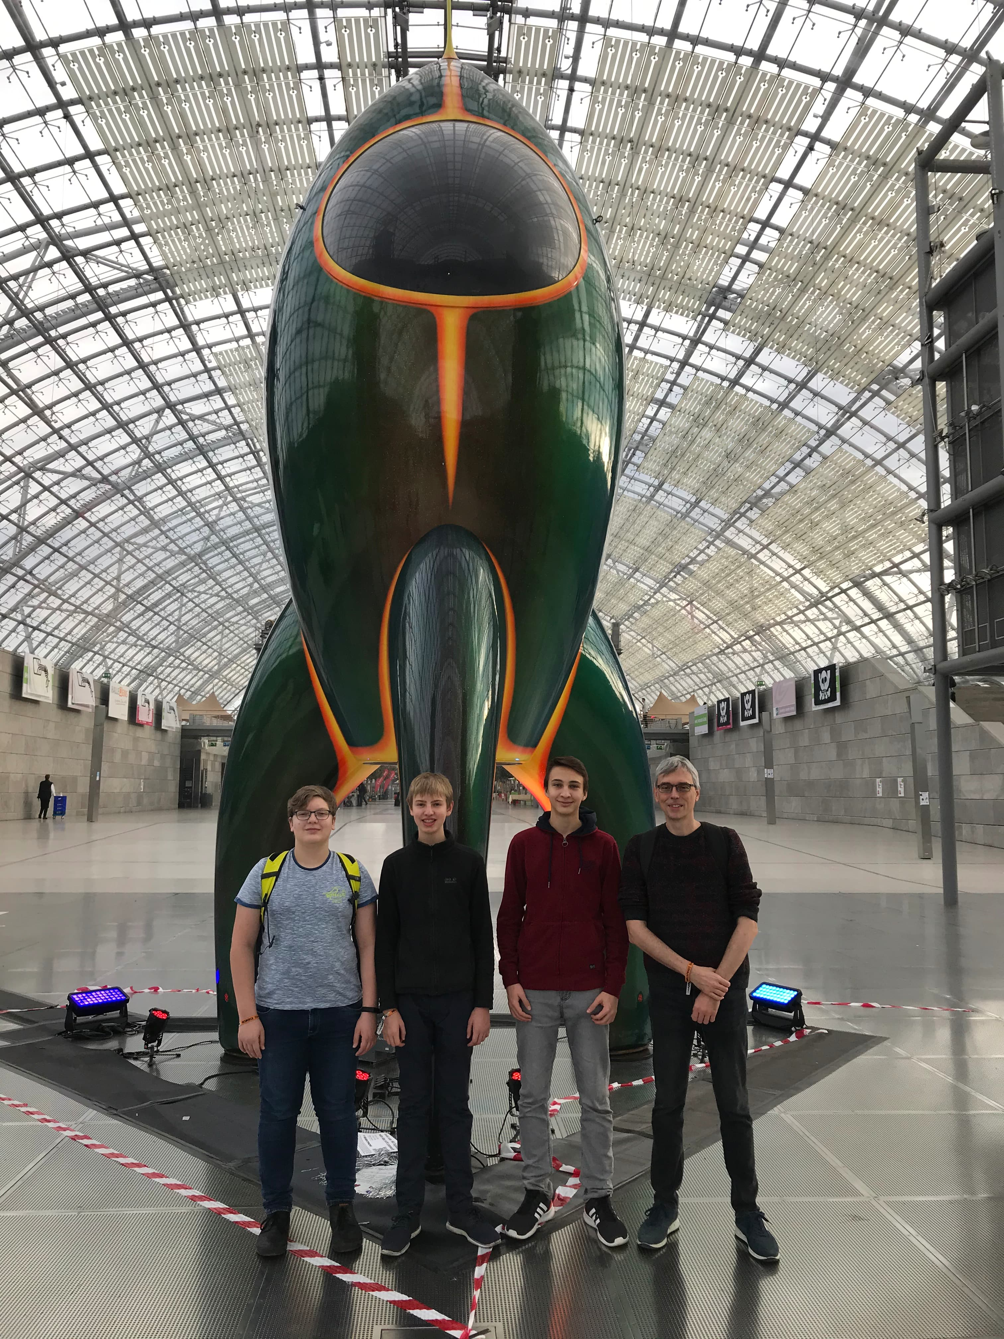


Vortrag CCC Leipzig

Slide 26
Zu unserer Website:
www.domspatzen-quantum.de
mail@domspatzen-quantum.de
Notes:
Website mit git, Doku; Kontakt

